Slide 1
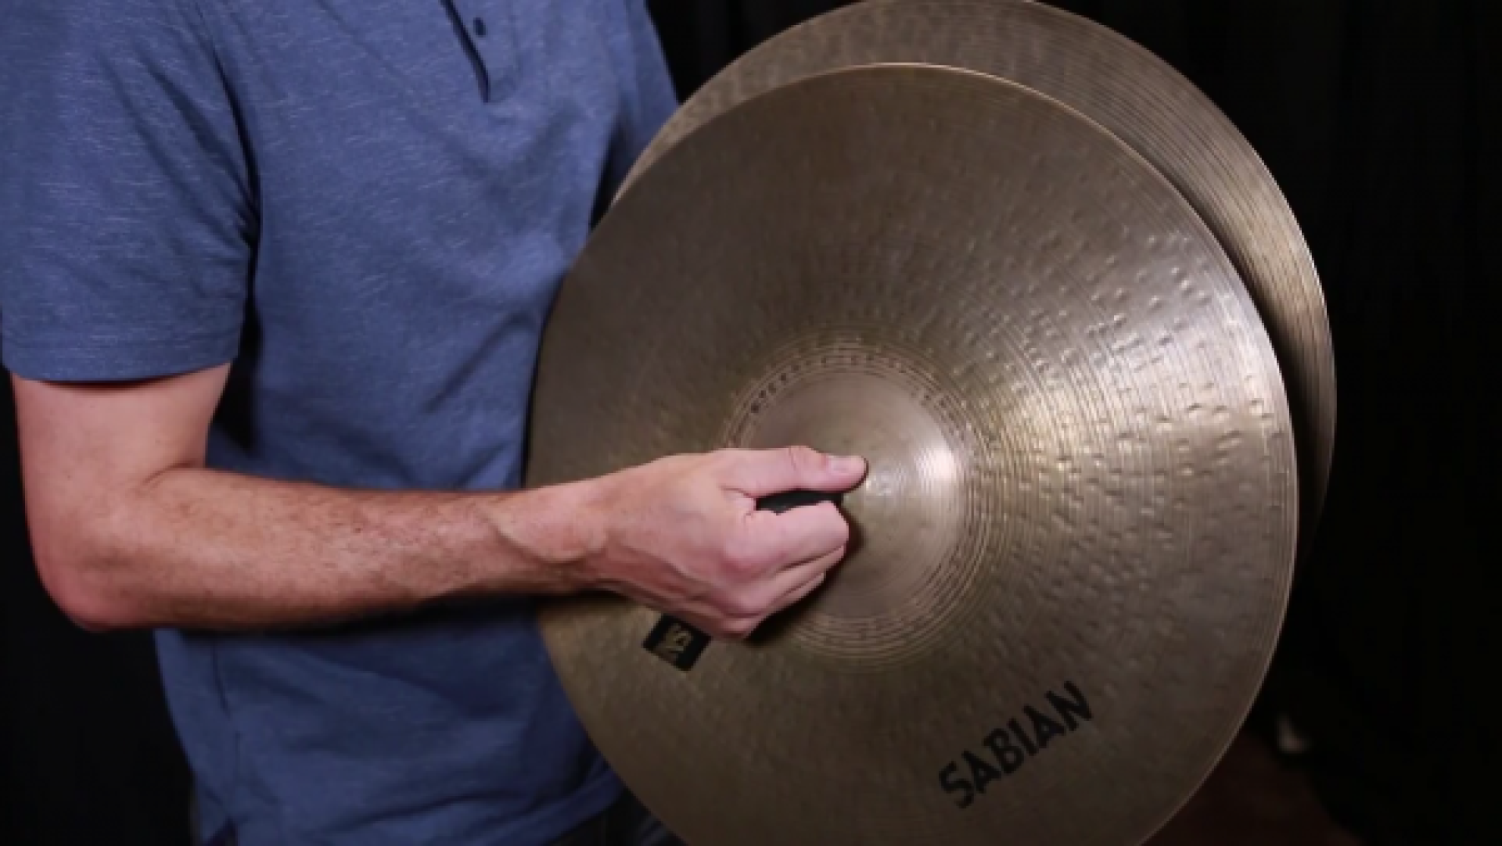
Notes:
Clash cymbals

Slide 2
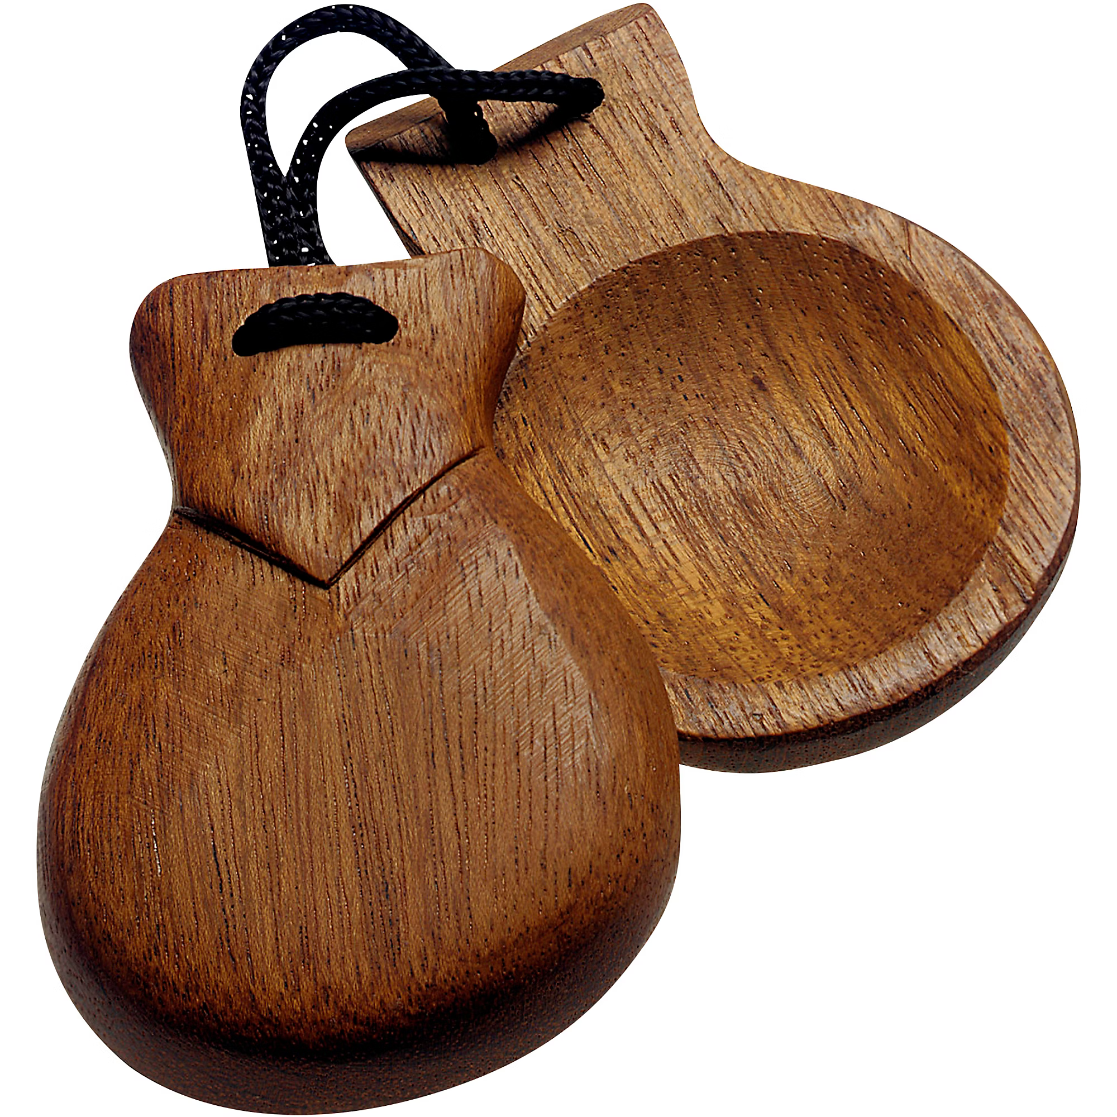
Notes:
Castinets

Slide 3
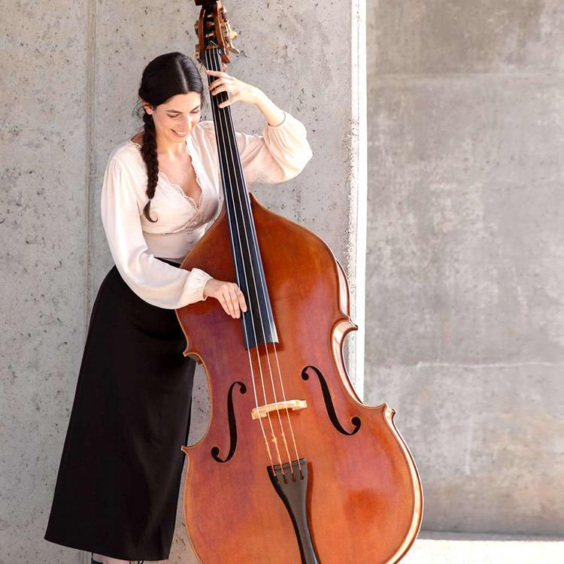
Notes:
Upright bass

Slide 4
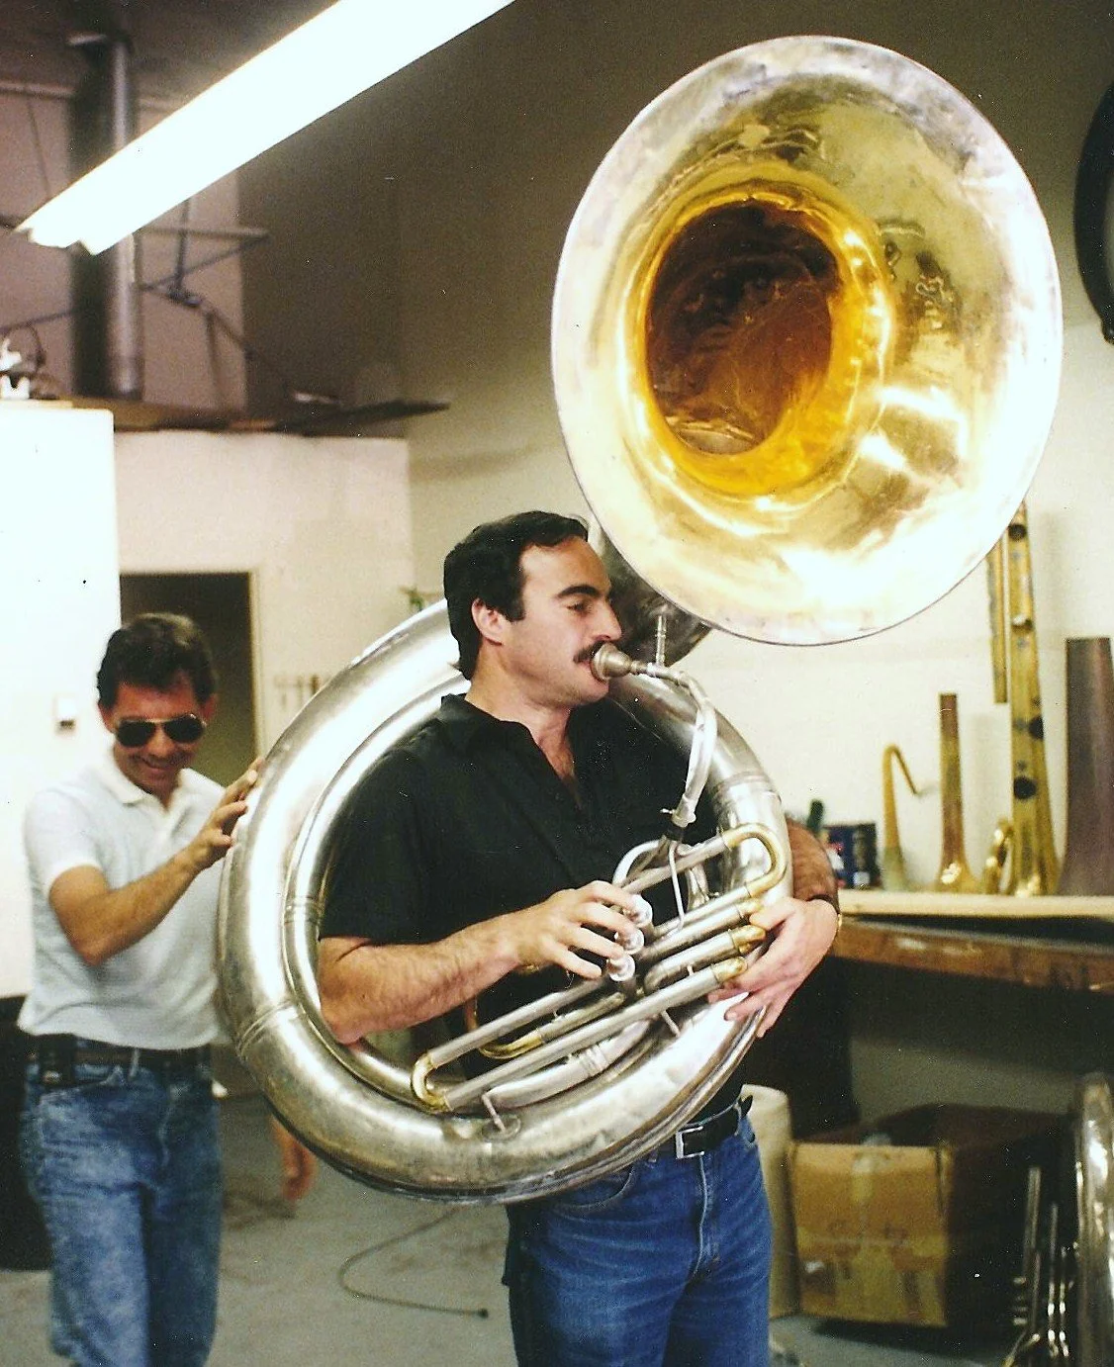
Notes:
Susaphone

Slide 5
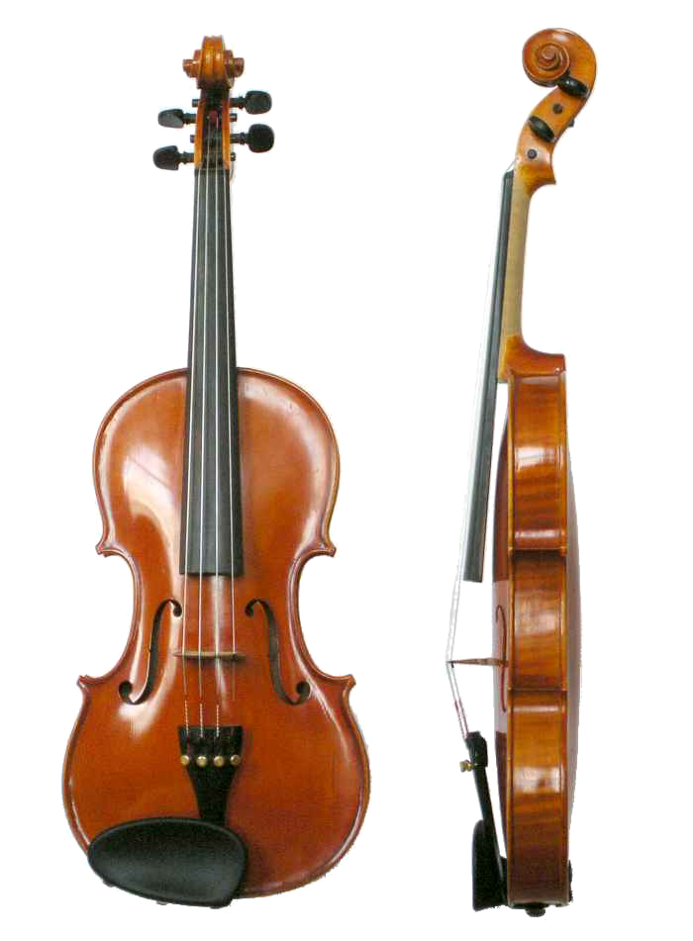
Notes:
violin

Slide 6
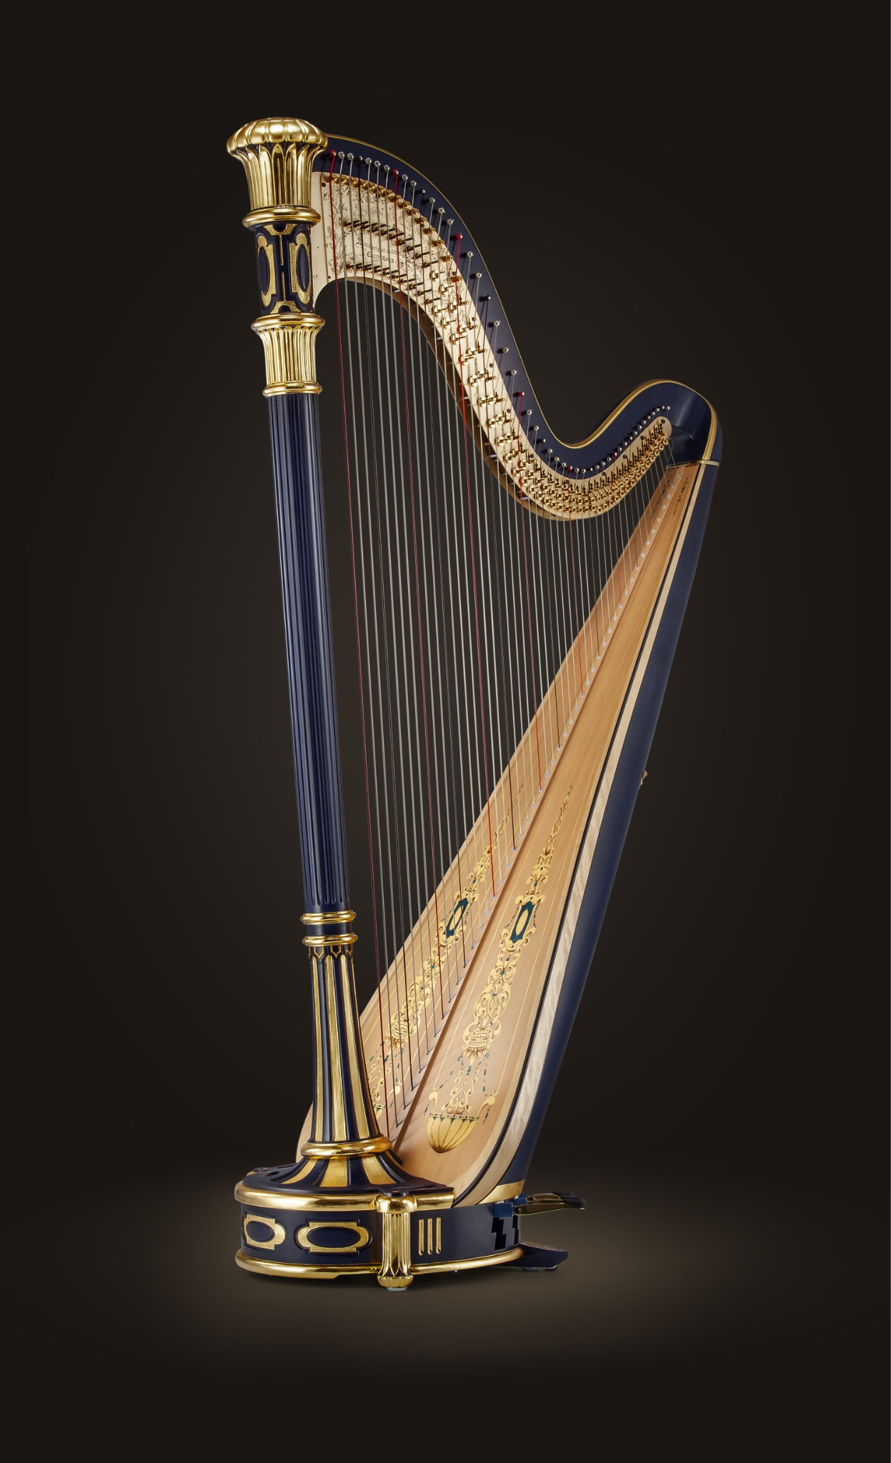
Notes:
harp

Slide 7
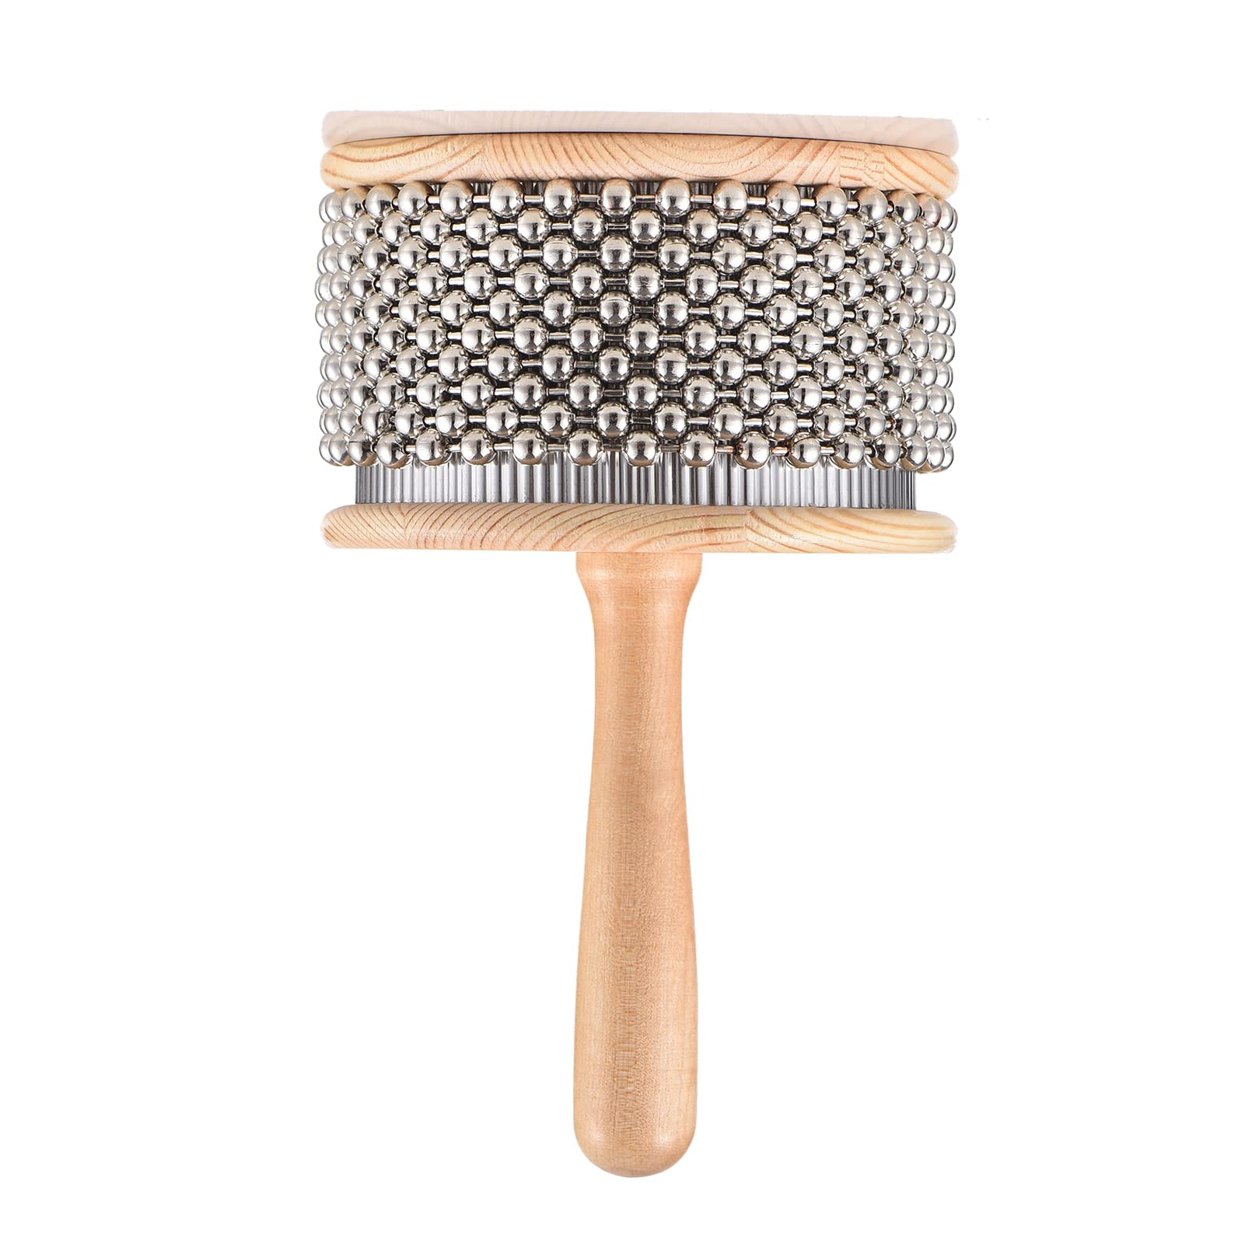
Notes:
Cabasa

Slide 8
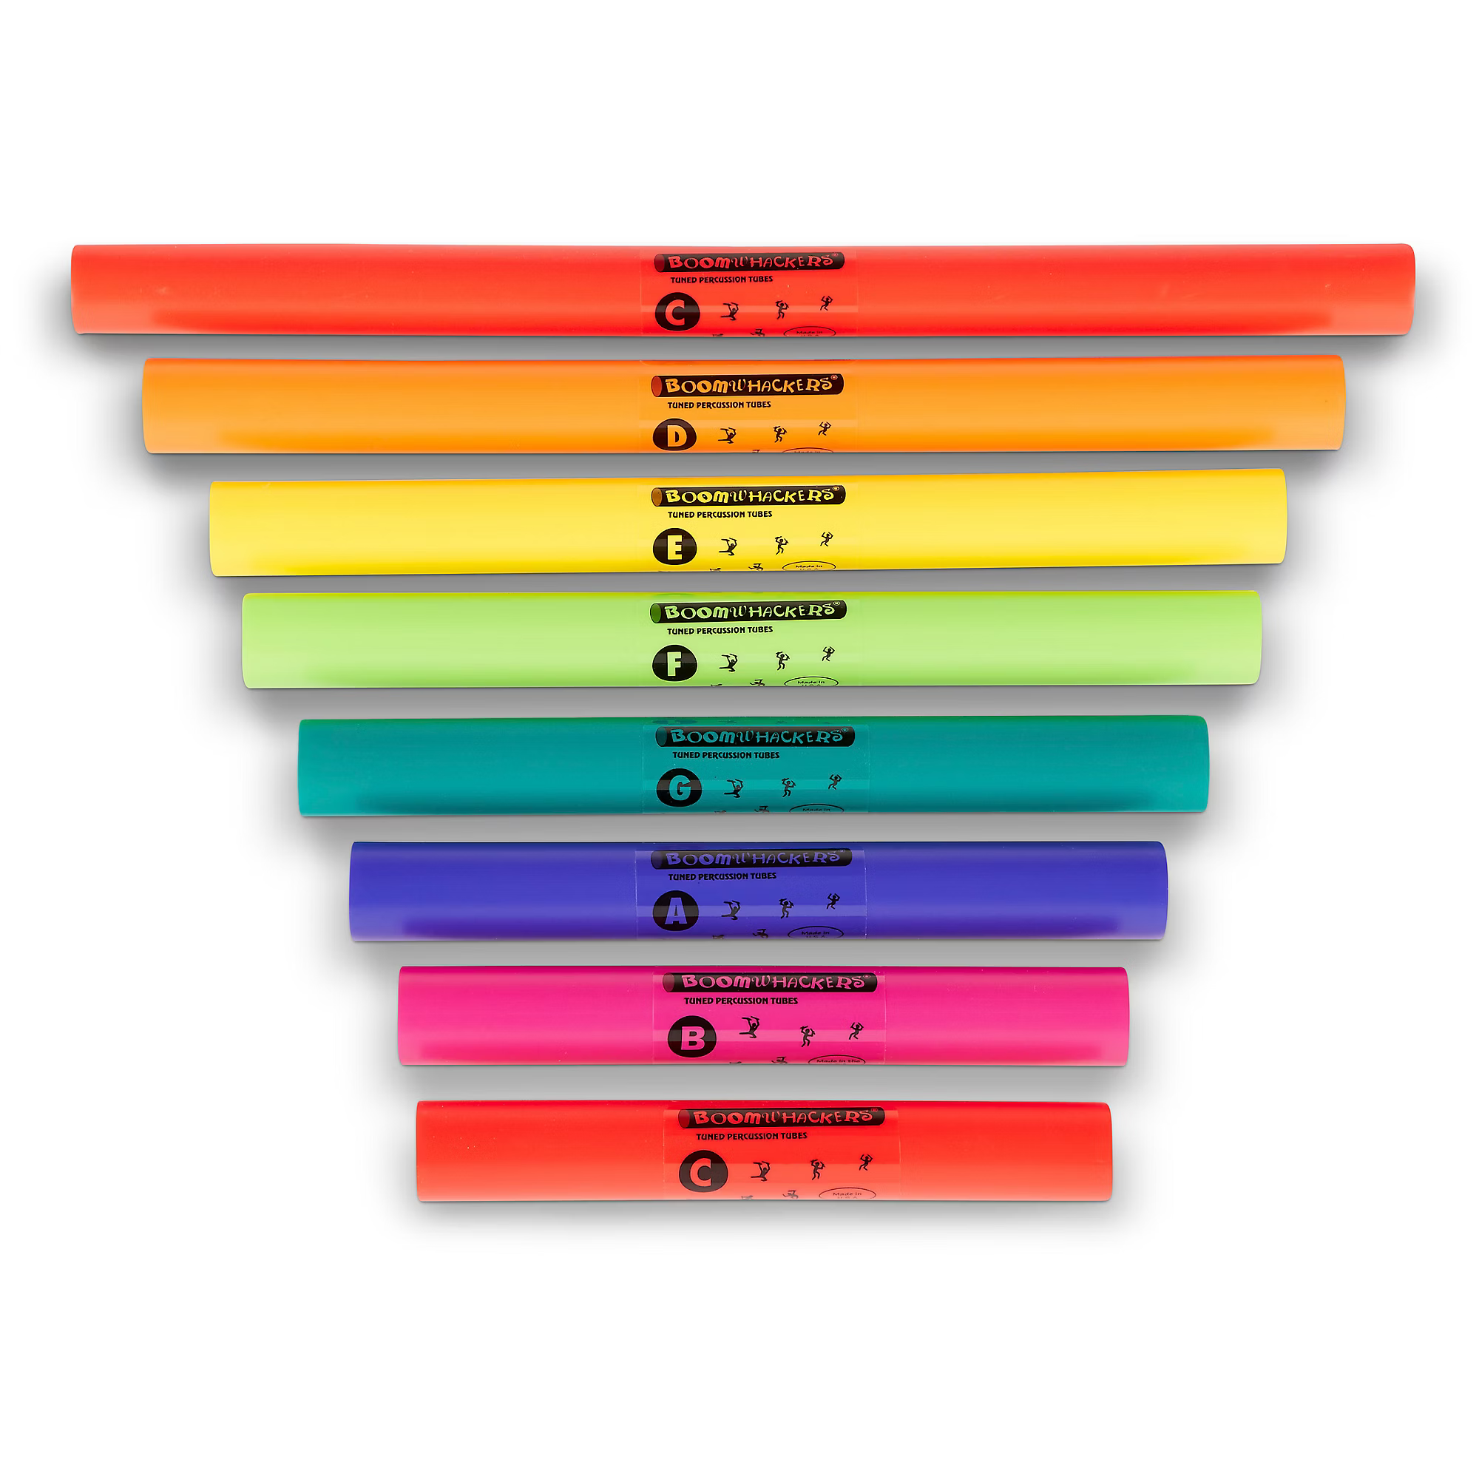
Notes:
Boomwhacker

Slide 9
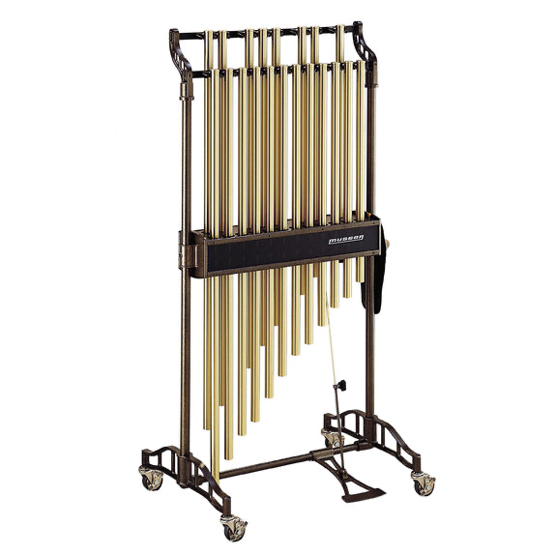
Notes:
chimes

Slide 10
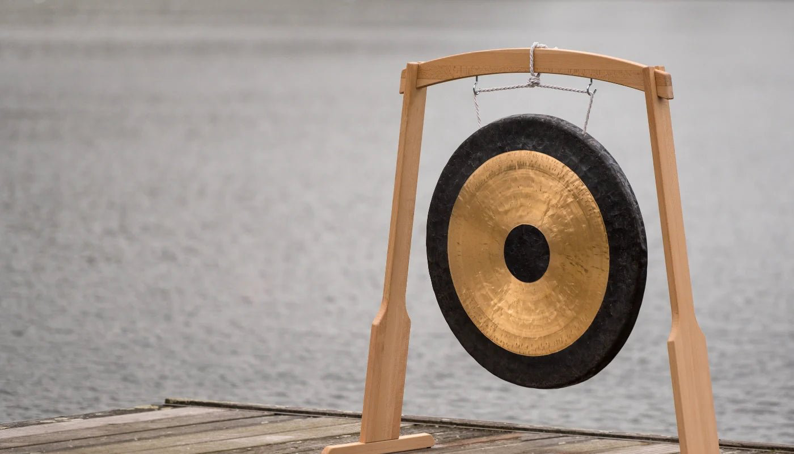
Notes:
gong

Slide 11
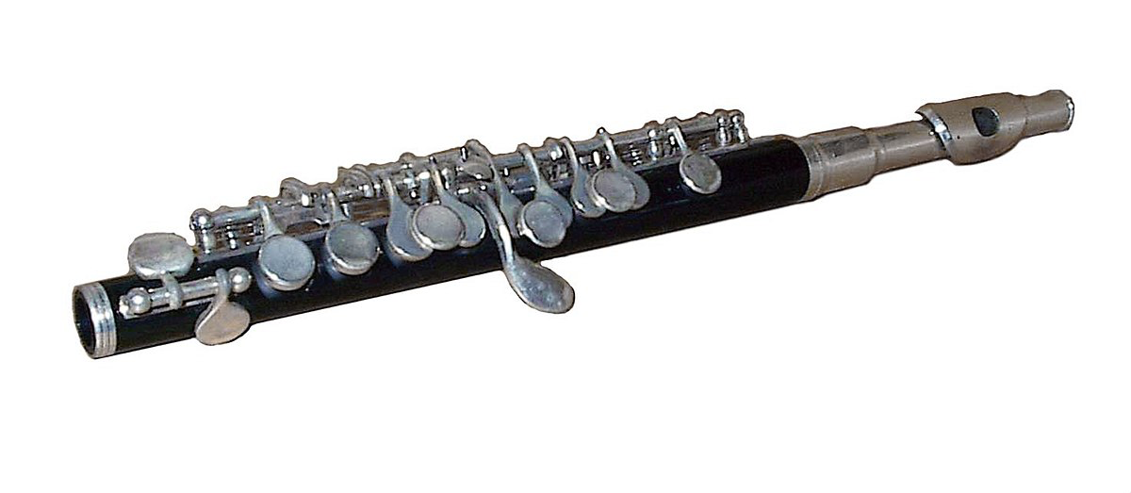
Notes:
piccolo

Slide 12
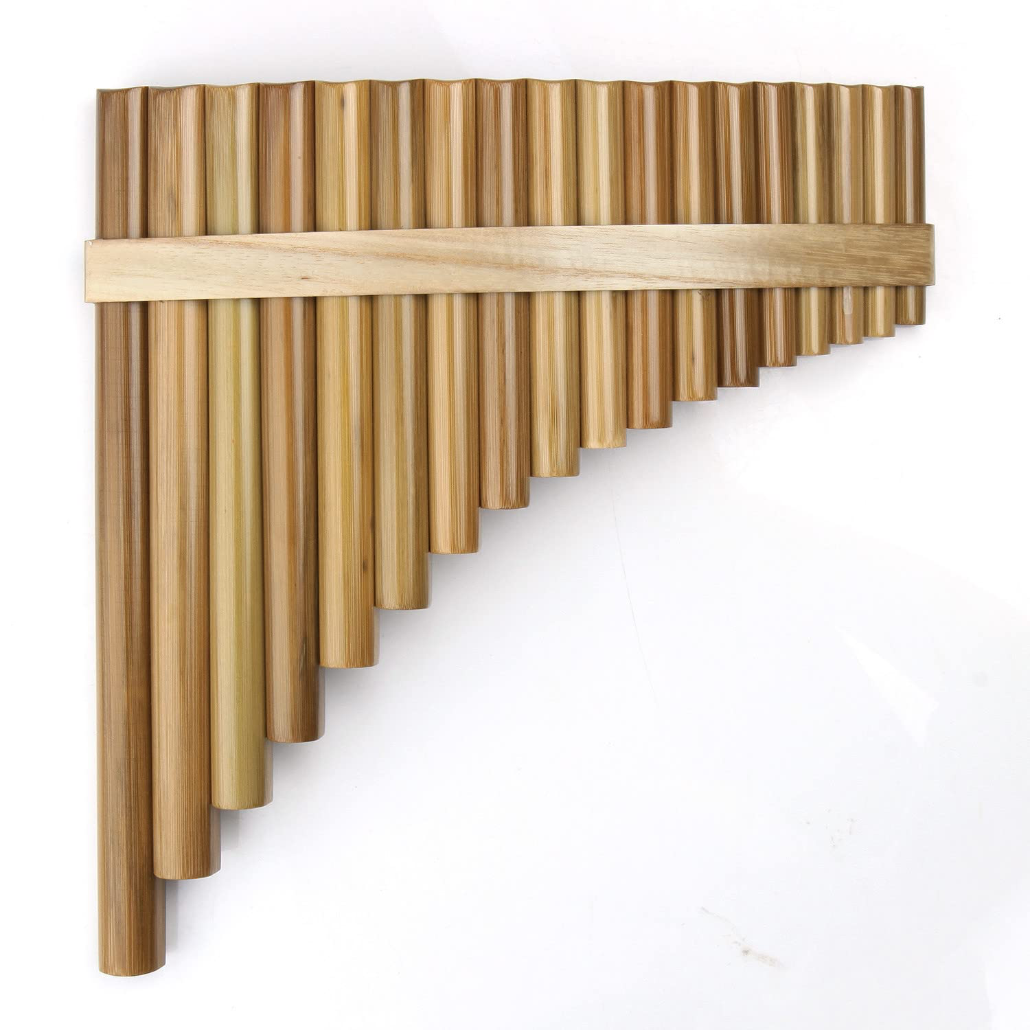
Notes:
Pan flute

Slide 13
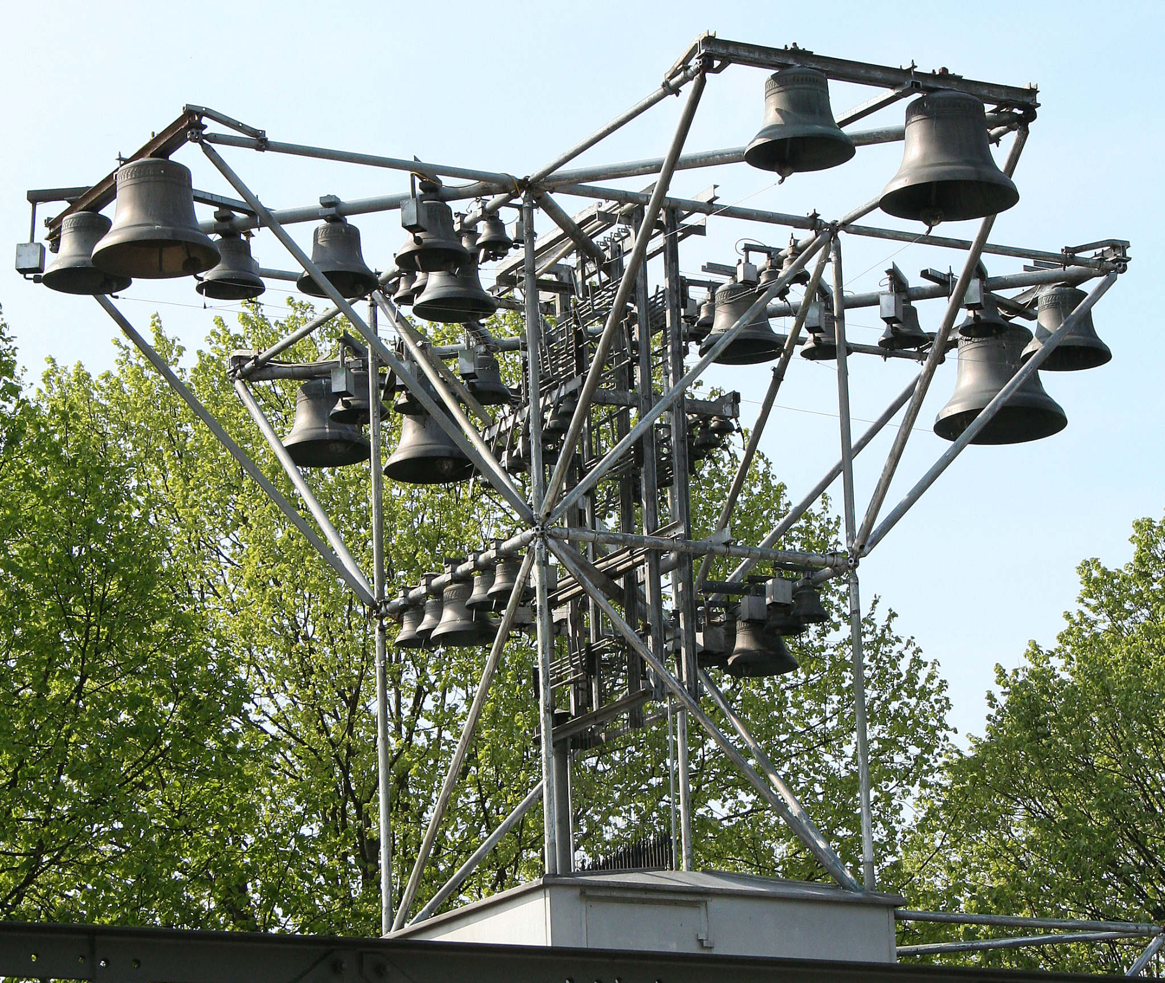
Notes:
Carillon

Slide 14
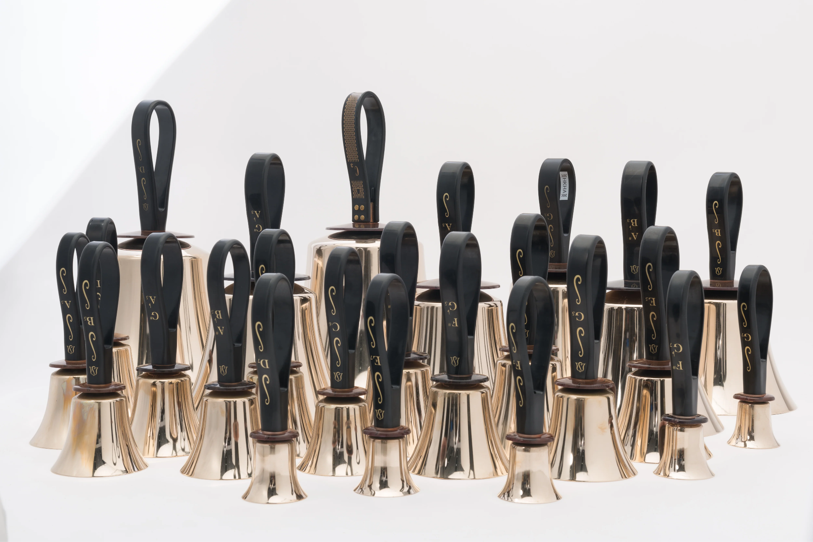
Notes:
handbells

Slide 15
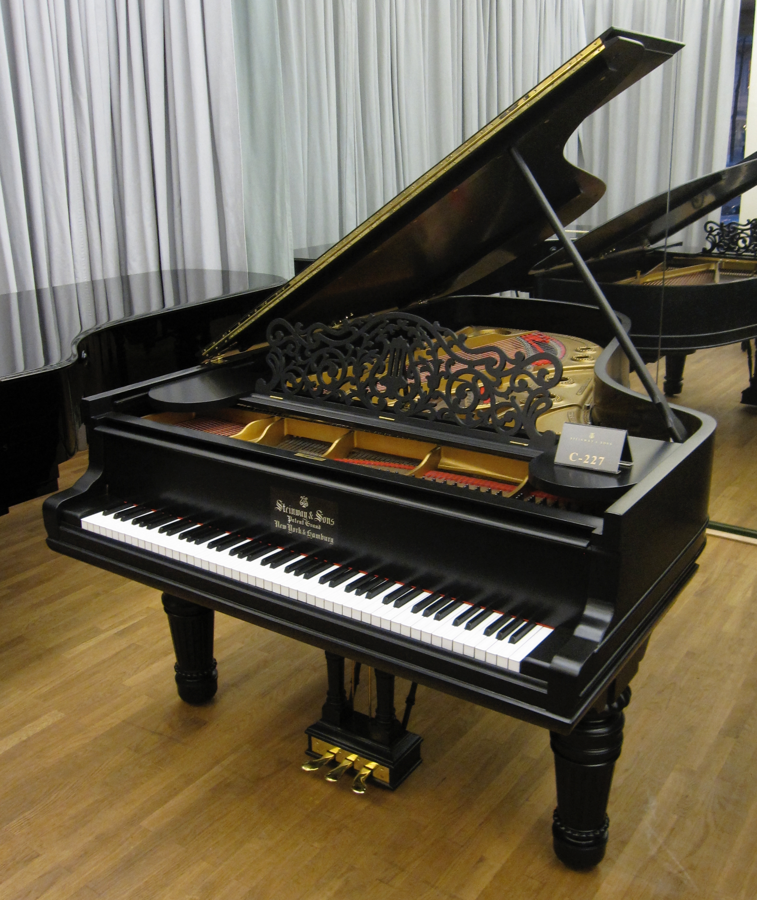
Notes:
piano

Slide 16
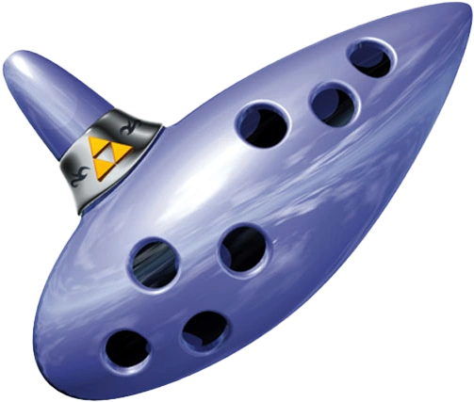
Notes:
Ocarina of Time

Slide 17
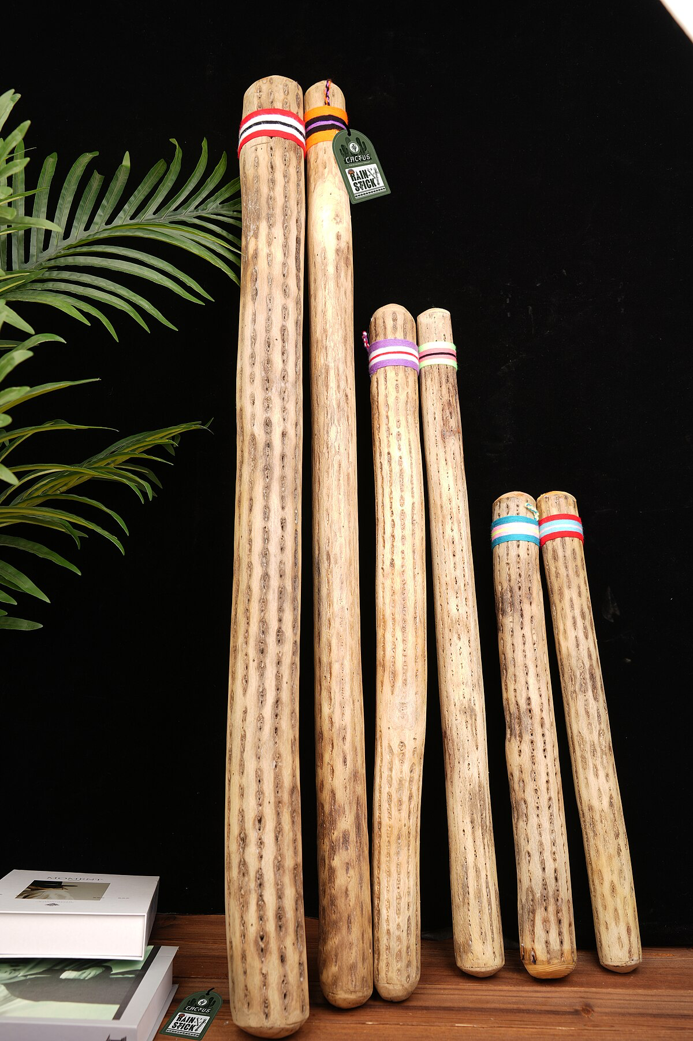
Notes:
rainstick

Slide 18
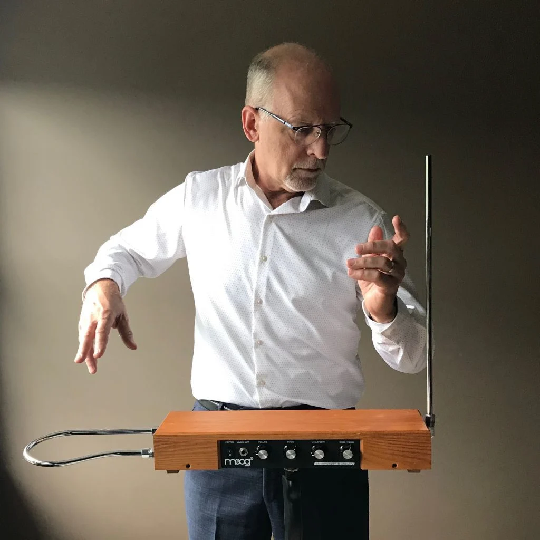
Notes:
theremin

Slide 19
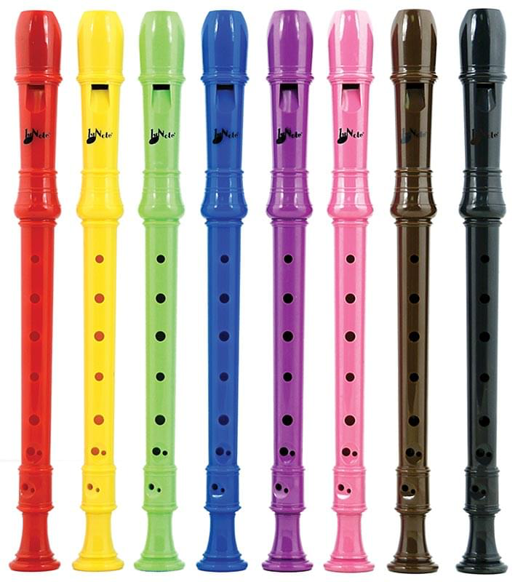
Notes:
recorder

Slide 20
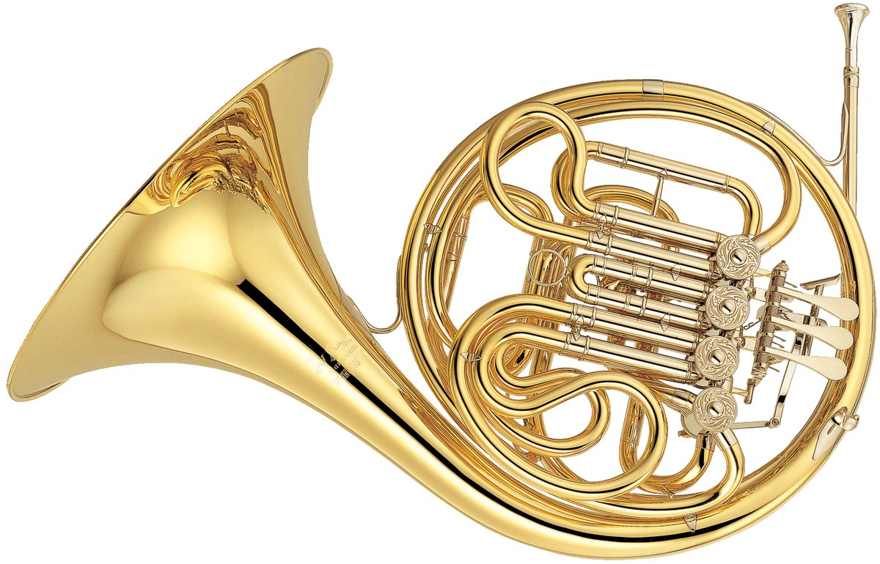
Notes:
French horn

Slide 21
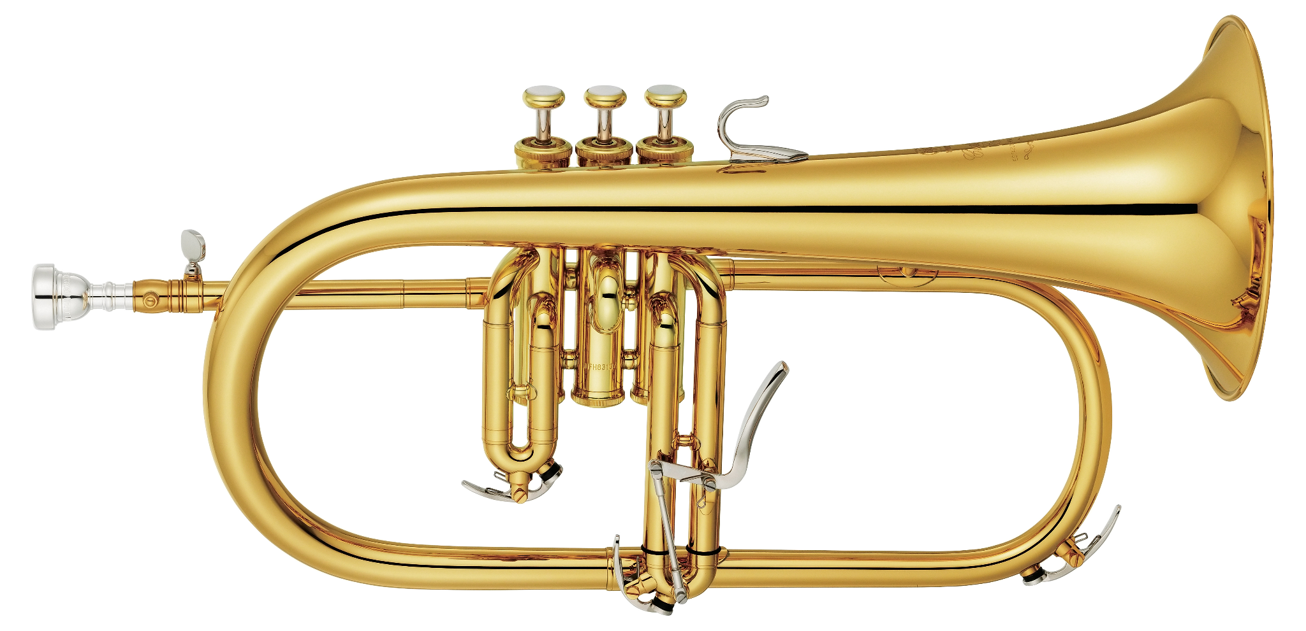
Notes:
Flugelhorn

Slide 22
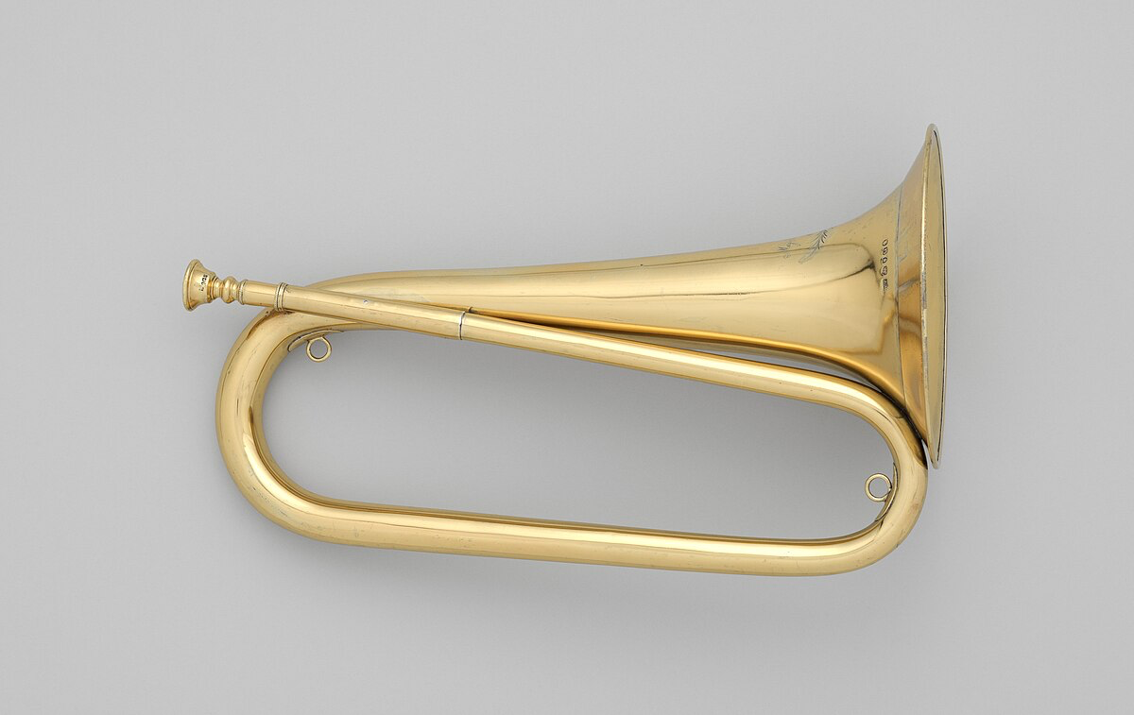
Notes:
Bugle

Slide 23
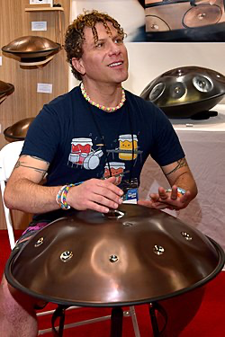
Notes:
handpan

Slide 24
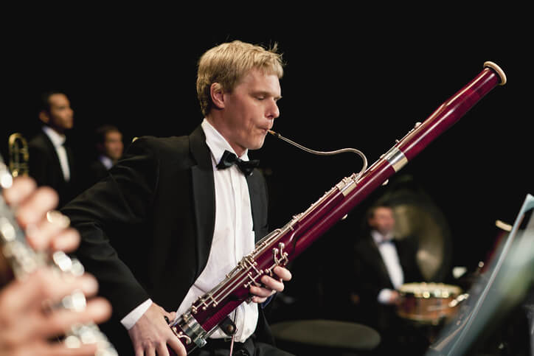
Notes:
Bassoon

Slide 25
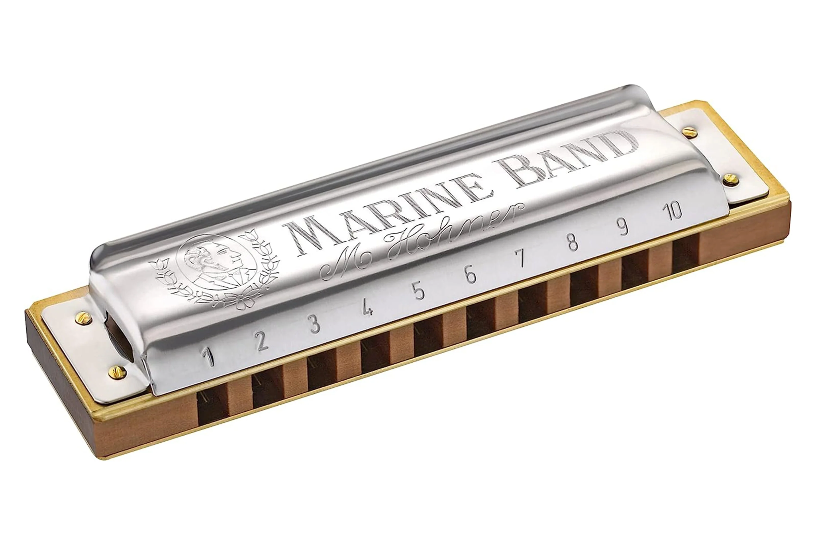
Notes:
harmonica

Slide 26
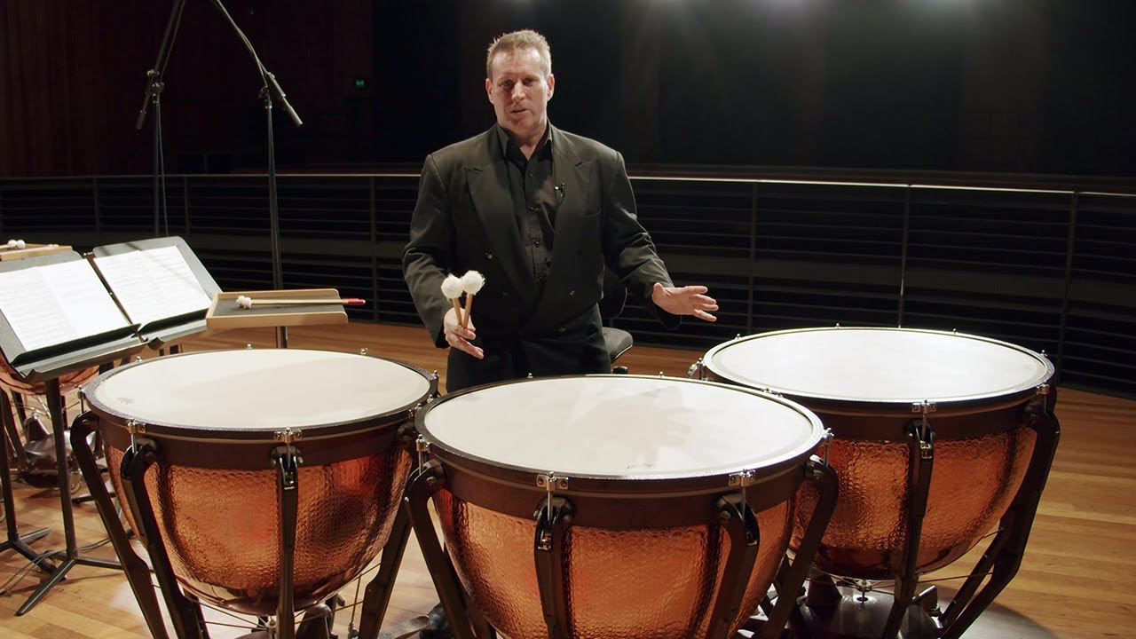
Notes:
timpani

Slide 27
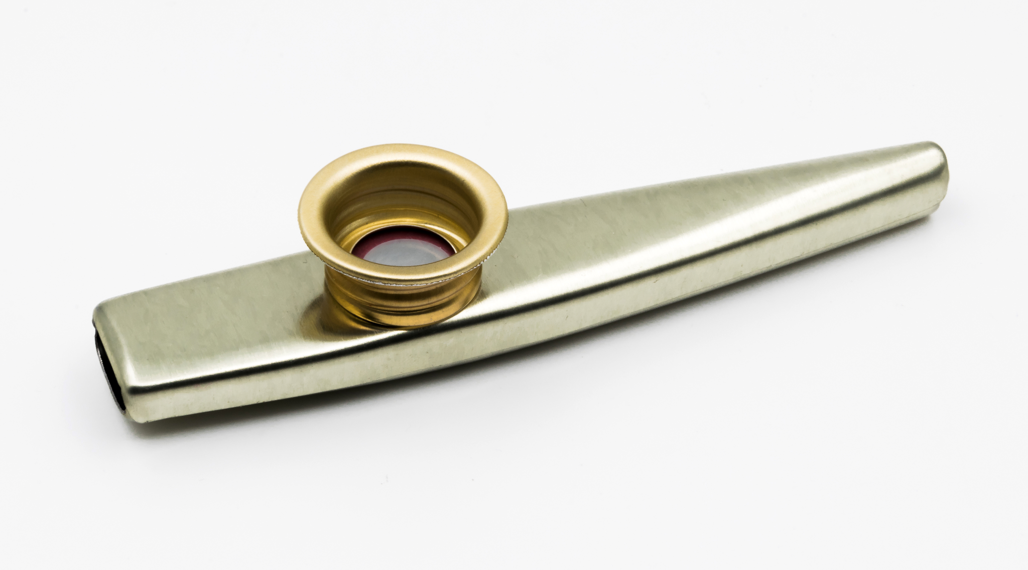
Notes:
kazoo

Slide 28
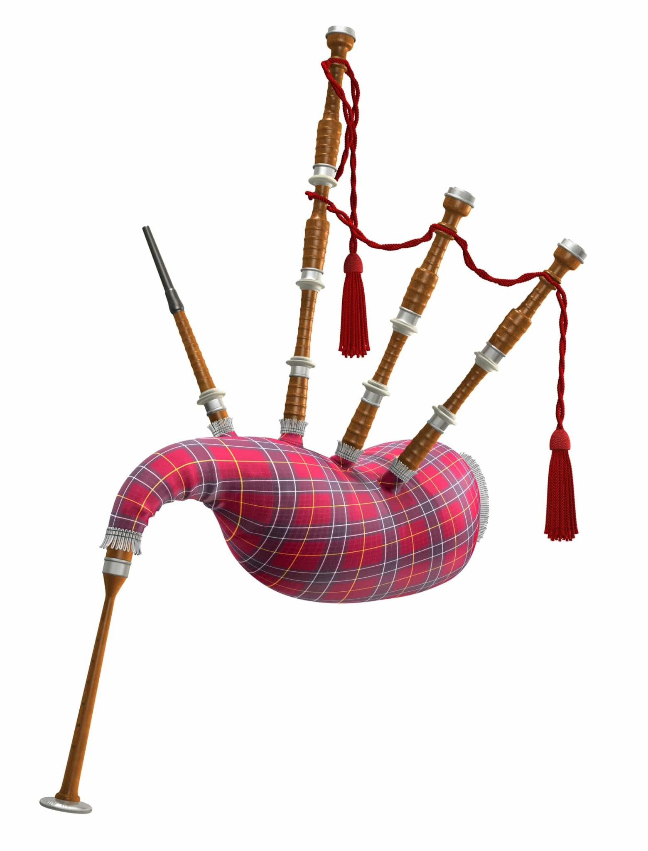
Notes:
bagpipe

Slide 29

Notes:
Clarinet

Slide 30
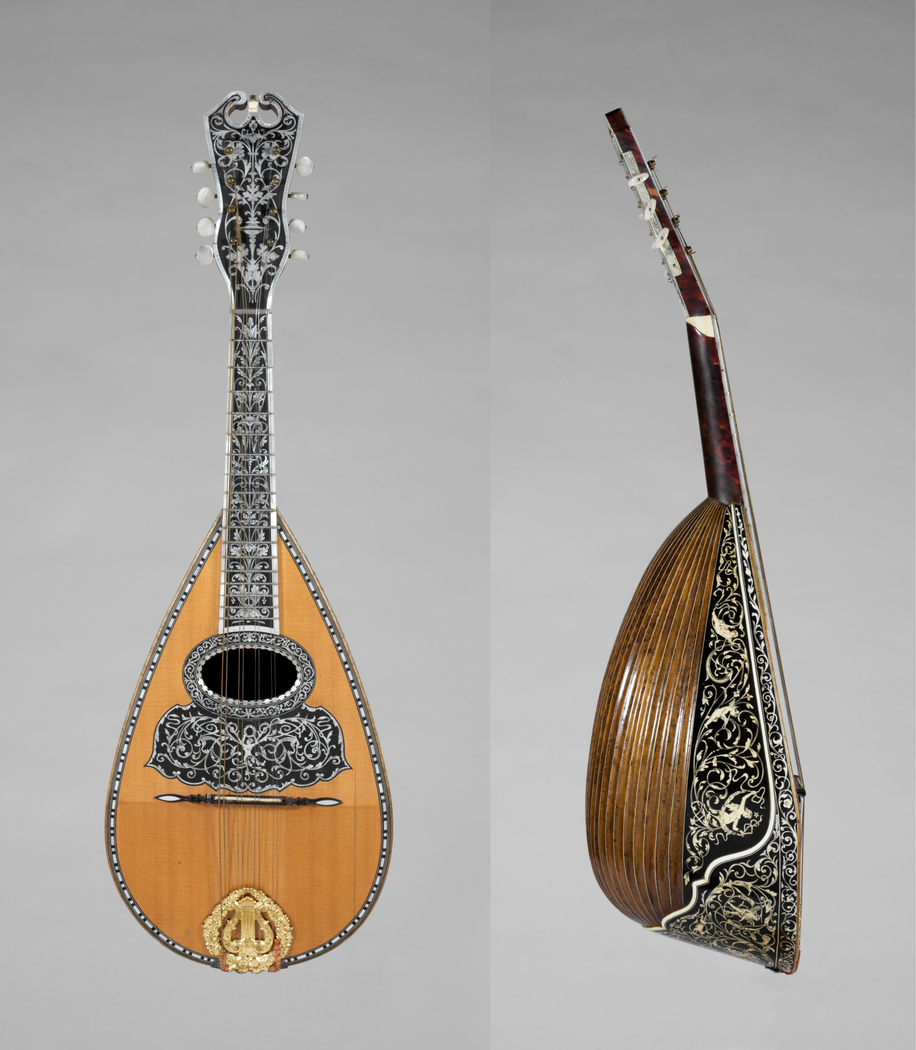
Notes:
mandolin

Slide 31
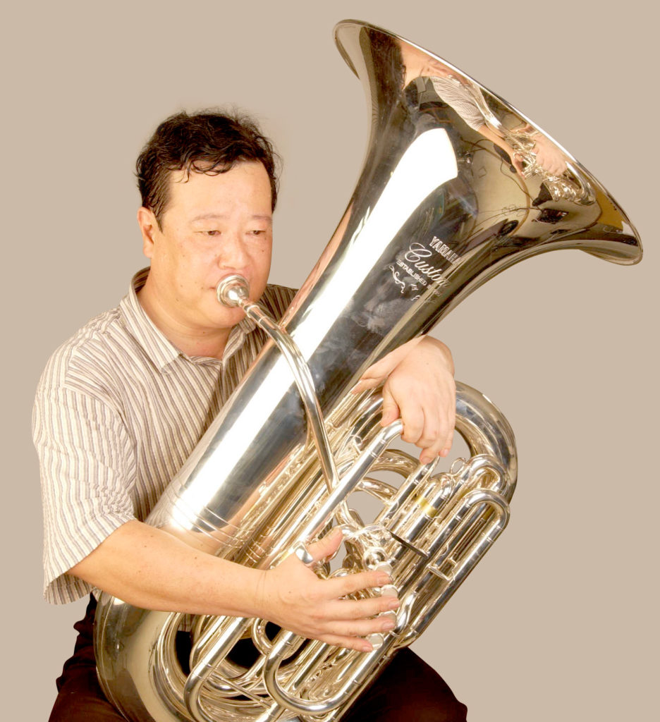
Notes:
tuba

Slide 32
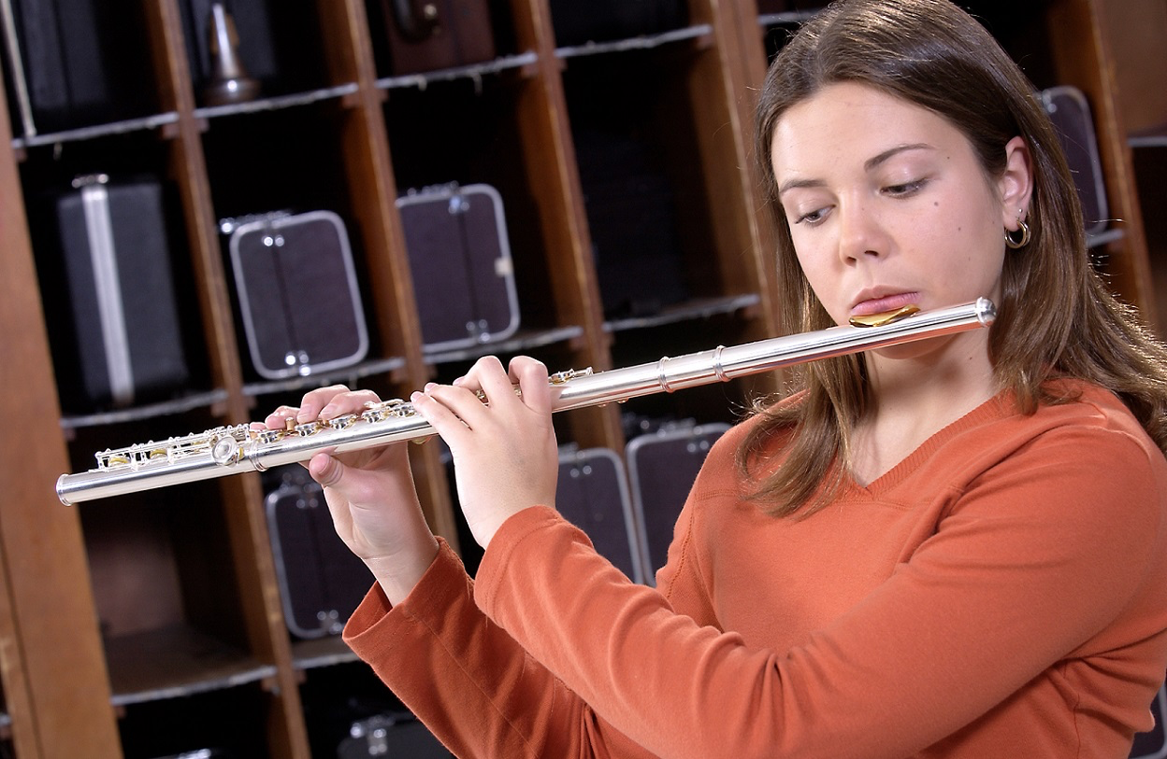
Notes:
Flute

Slide 33
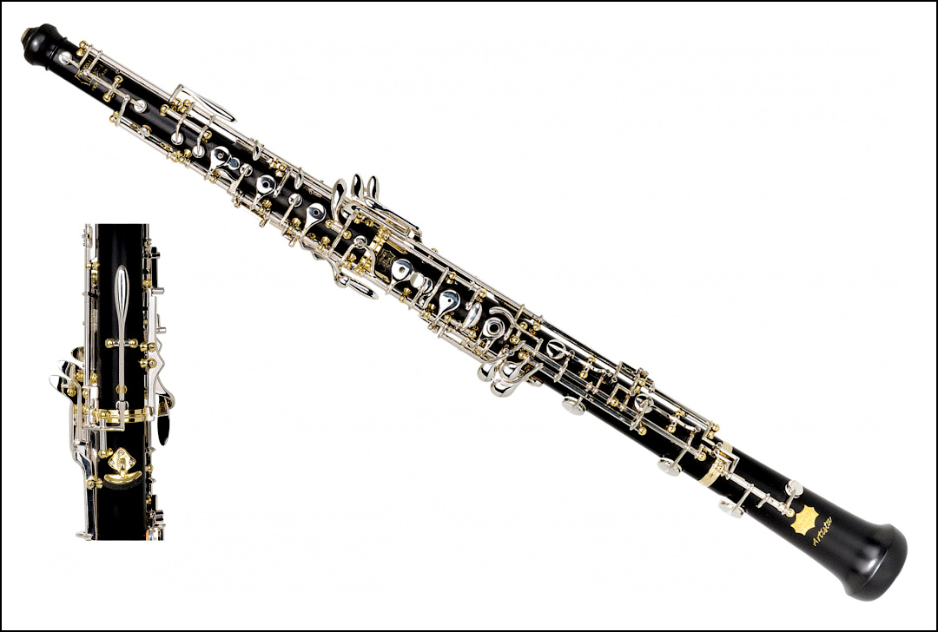
Notes:
Oboe

Slide 34
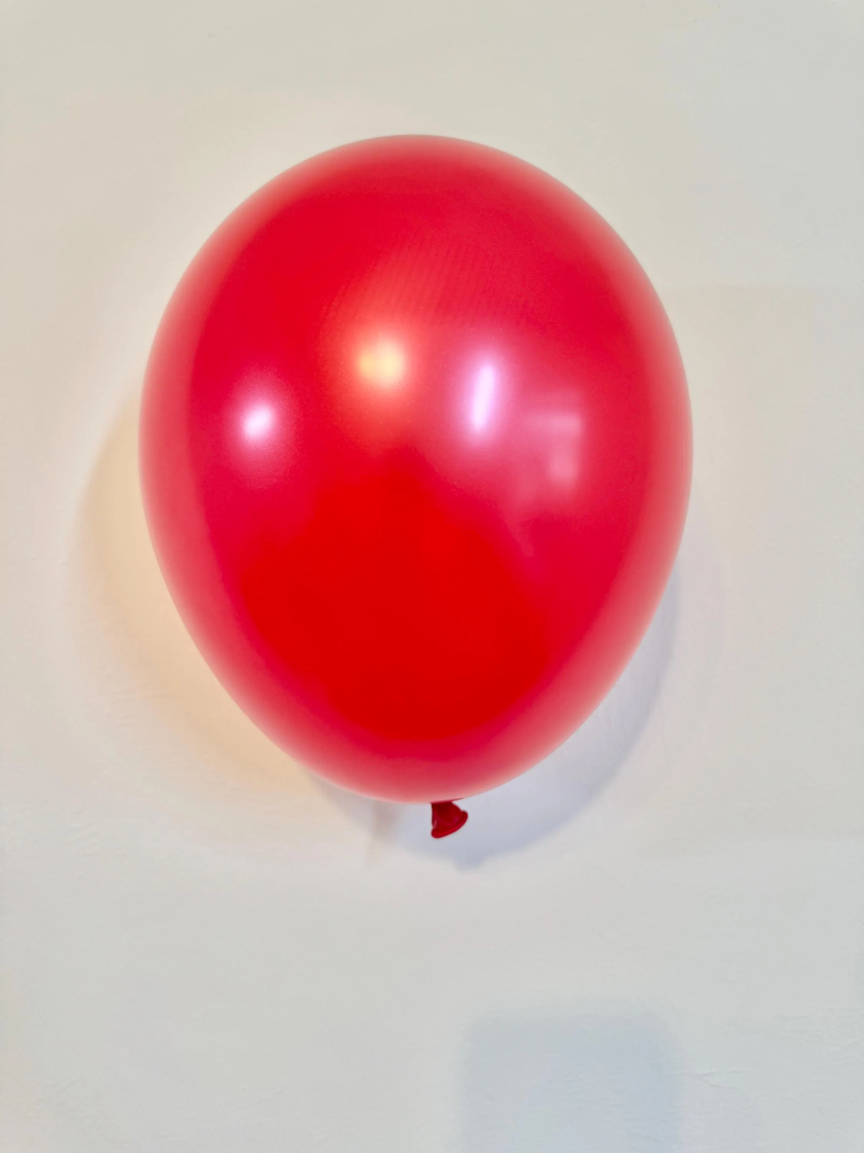
Notes:
Balloon

Slide 35
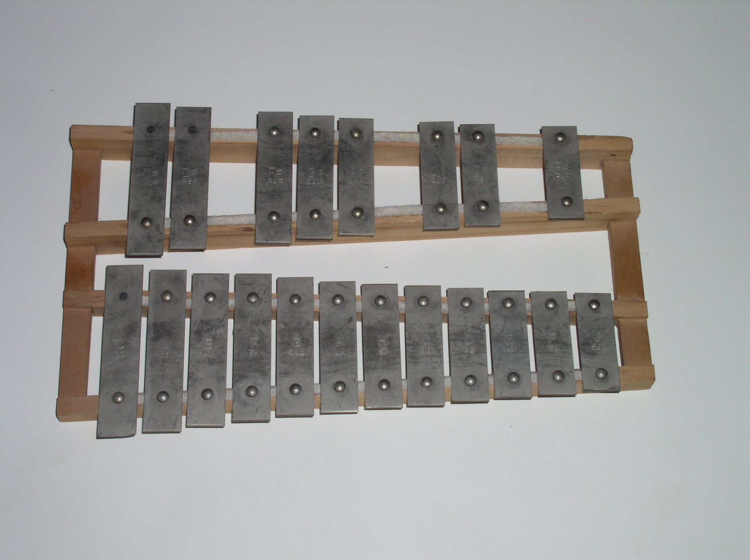
Notes:
Glockenspiel

Slide 36
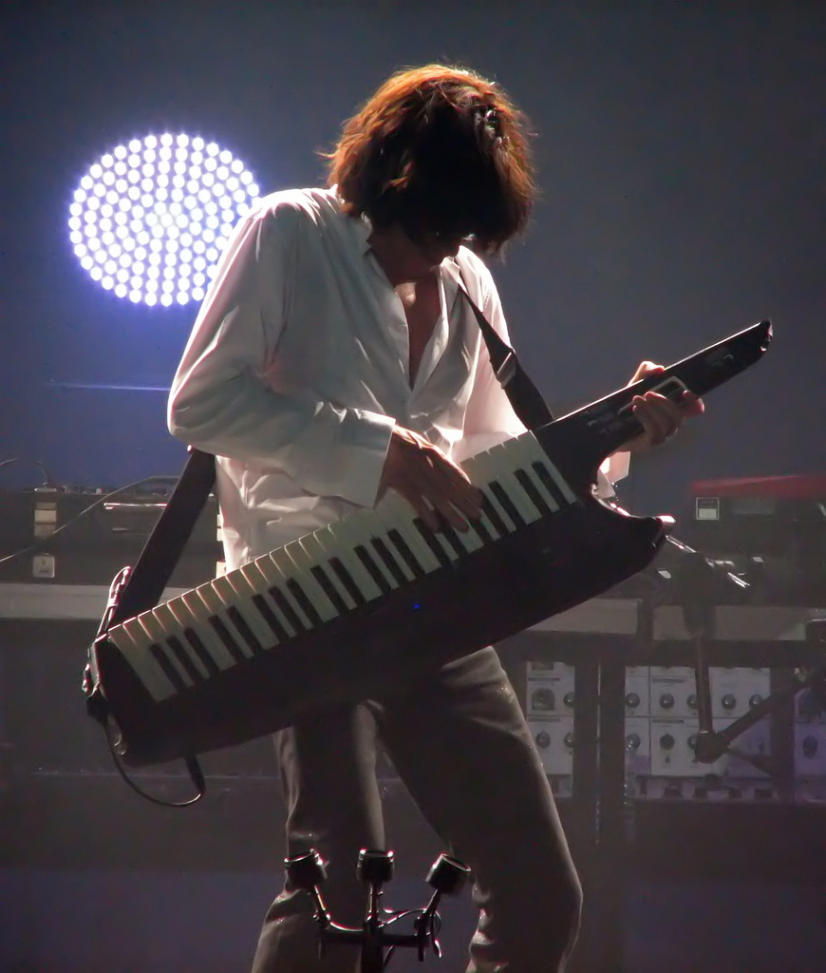
Notes:
Keytar

Slide 37
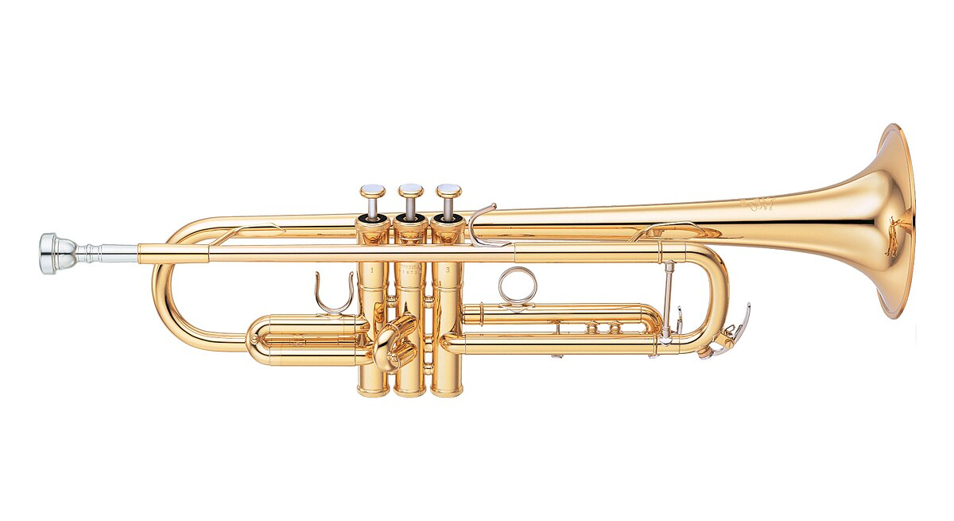
Notes:
trumpet

Slide 38
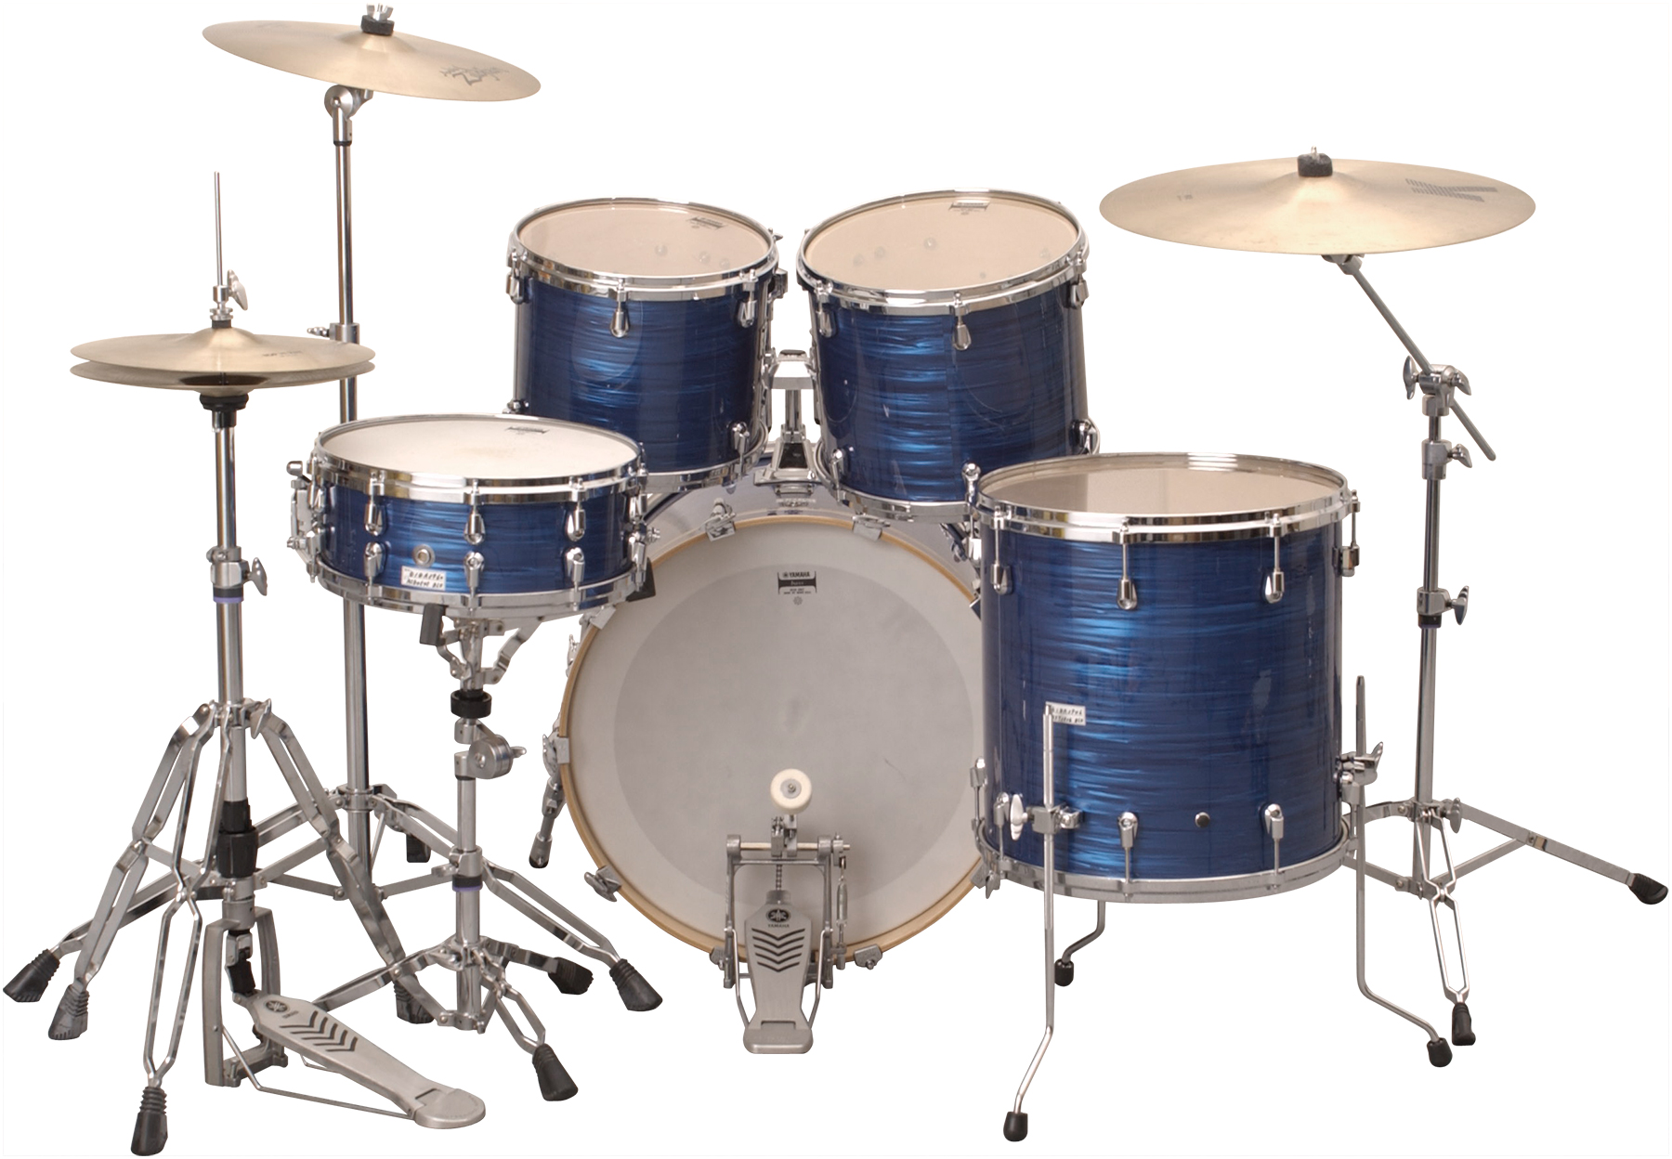
Notes:
Drum kit

Slide 39
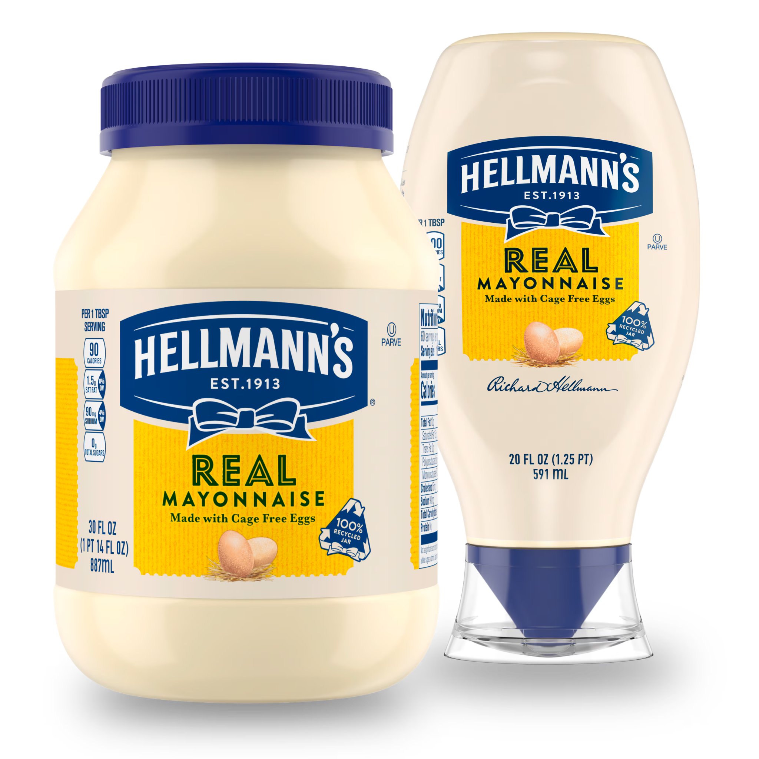
Notes:
mayonaisse

Slide 40
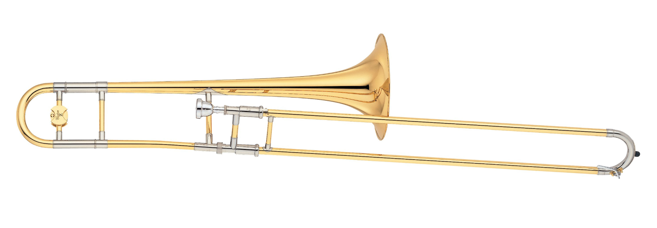
Notes:
Trombone

Slide 41
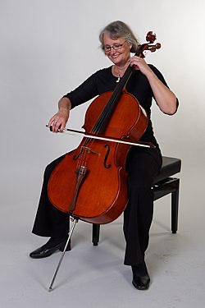
Notes:
cello

Slide 42
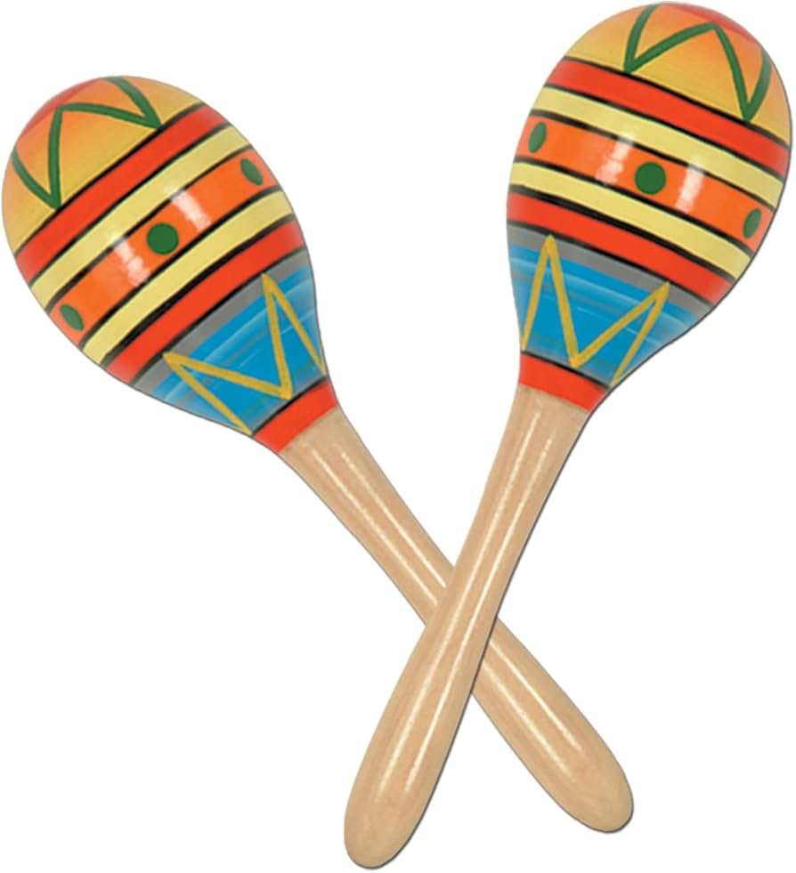
Notes:
maraca

Slide 43
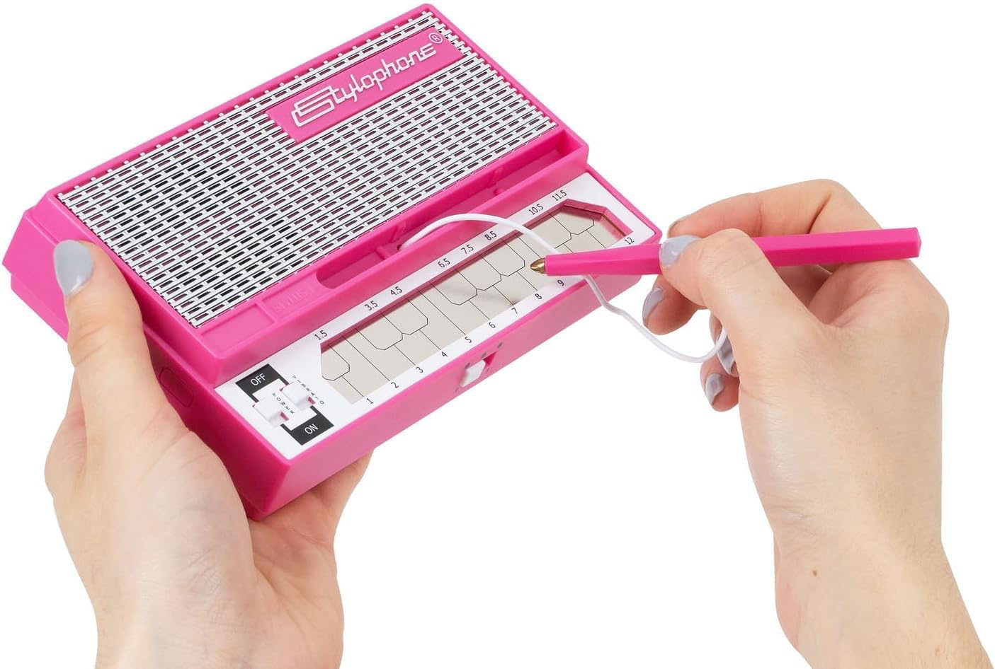
Notes:
stylophone

Slide 44
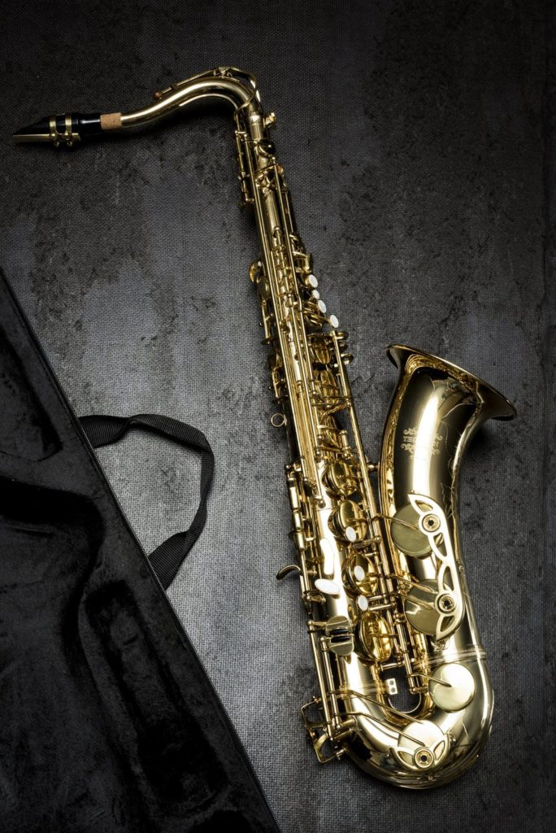
Notes:
sexophone

Slide 45
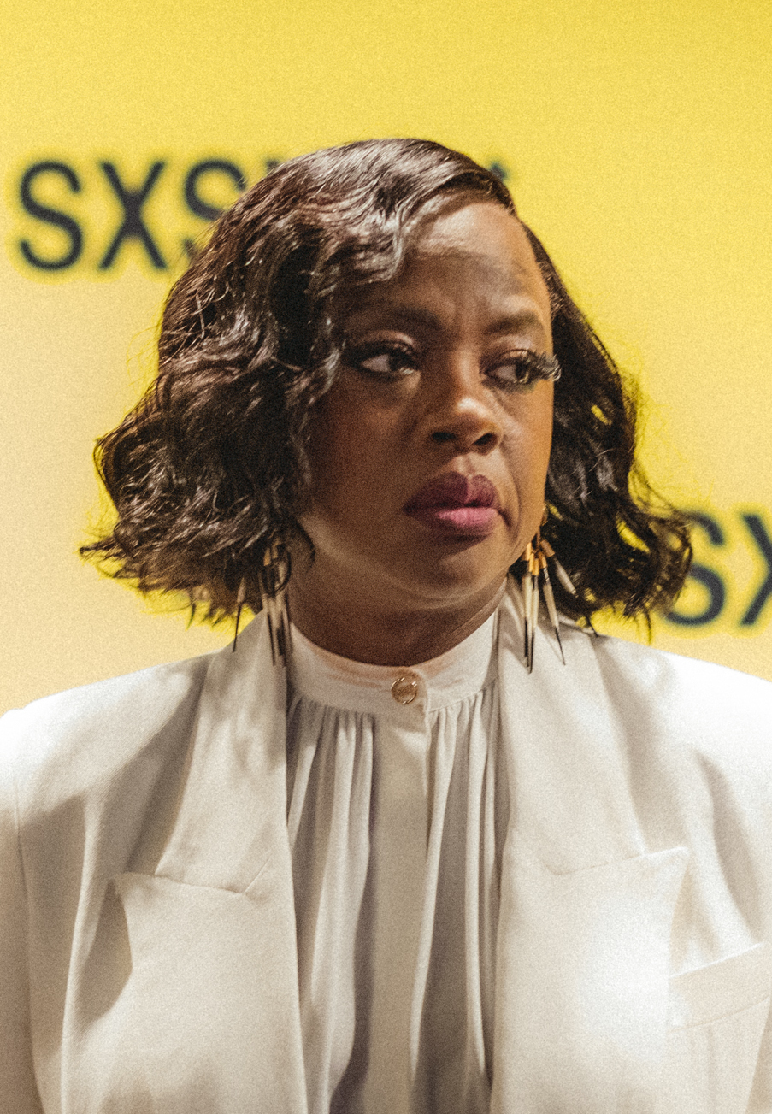
Notes:
Viola Davis

Slide 46
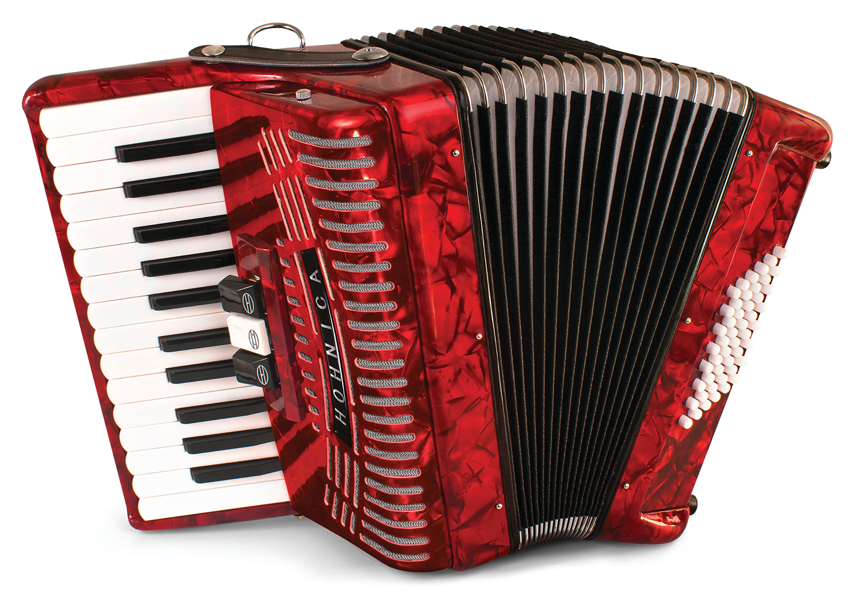
Notes:
accordion

Slide 47
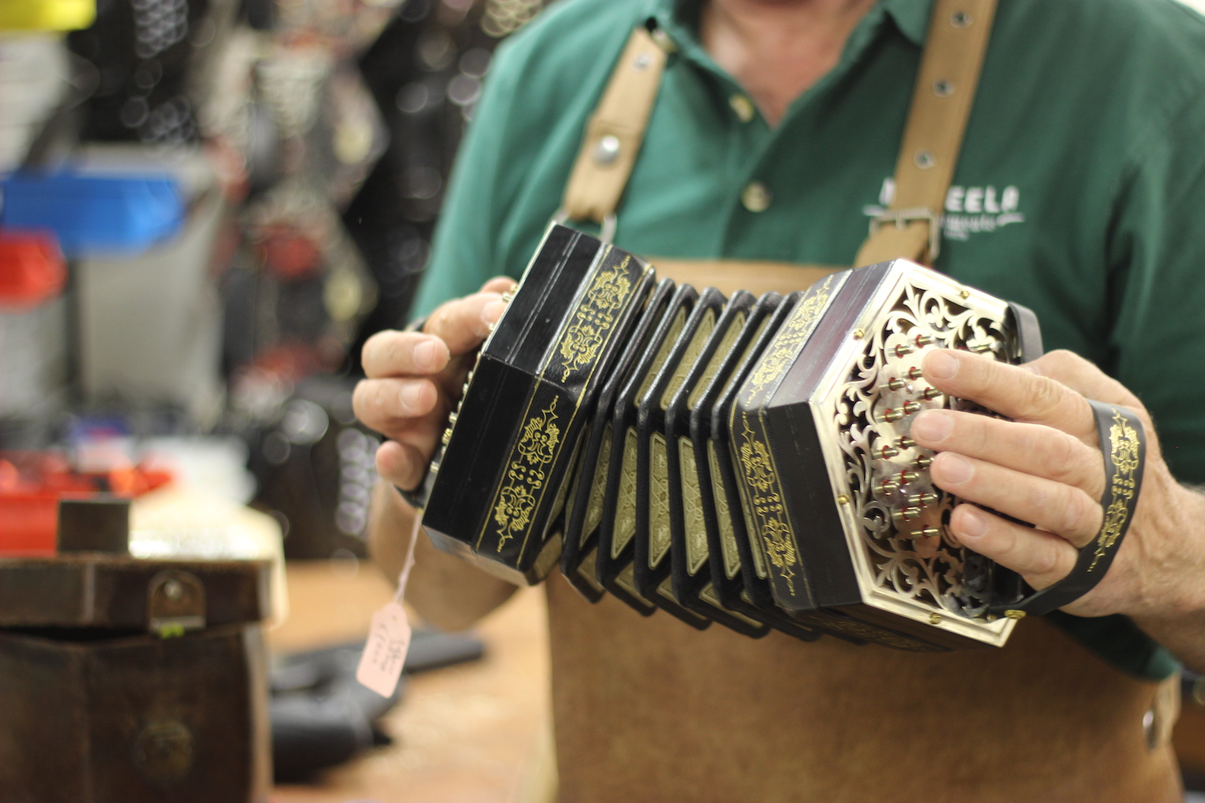
Notes:
Concertina

Slide 48
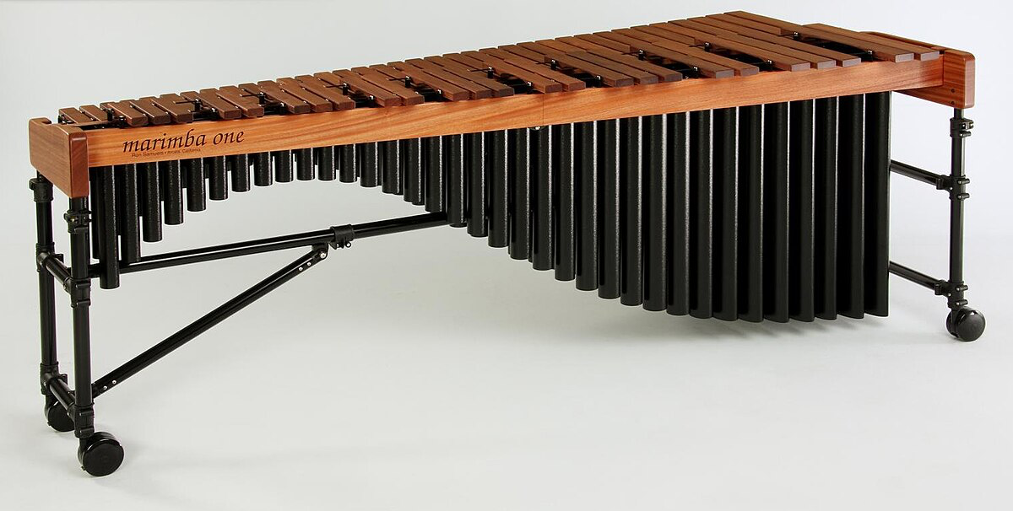
Notes:
Marimba

Slide 49
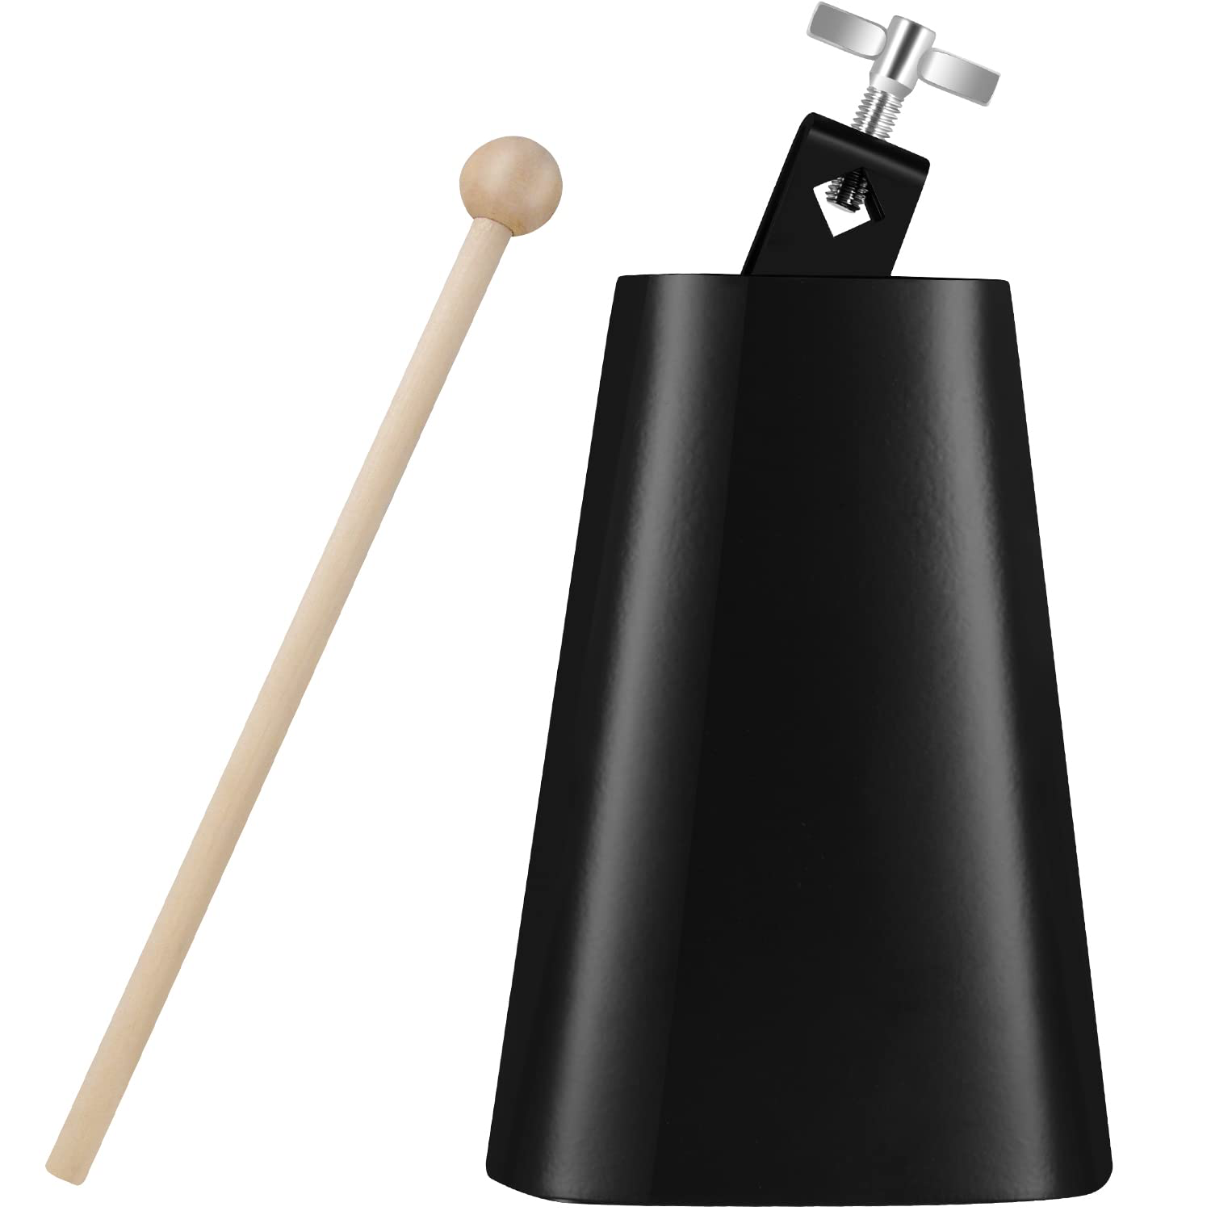
Notes:
cowbell

Slide 50
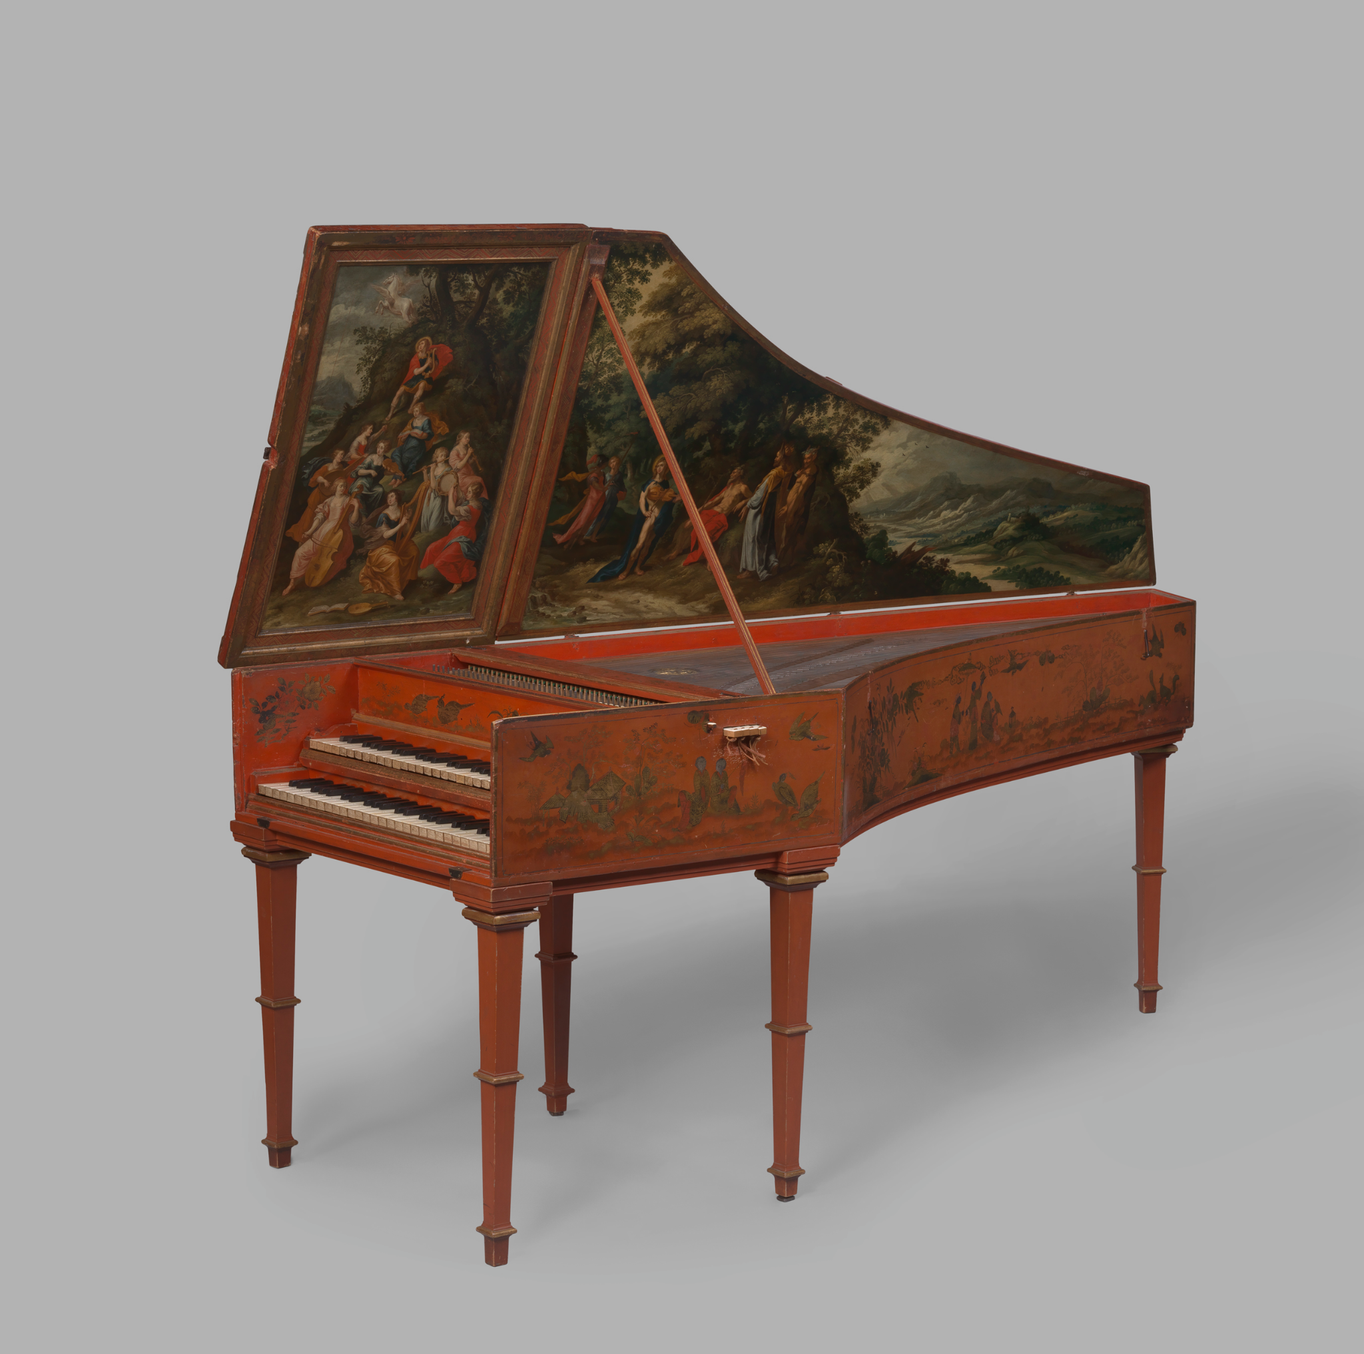
Notes:
harpsicord

